Slide 1
Ordination with unifrac distance matrix
With various age, gender subgroups and food tree levels

Slide 2
Male in 60s Lv2 and Lv3 – more variance explained?
Kind of yes –
Axis 1 of Lv3 weighted is high.
Lv2 weighted is as good as Lv4 weighted.
In general, PCoA with weighted (unifrac distance) is better than unweighted.
Order of levels of GLU_index is incorrect, but the results (var explained) itself is not wrong.

Slide 3
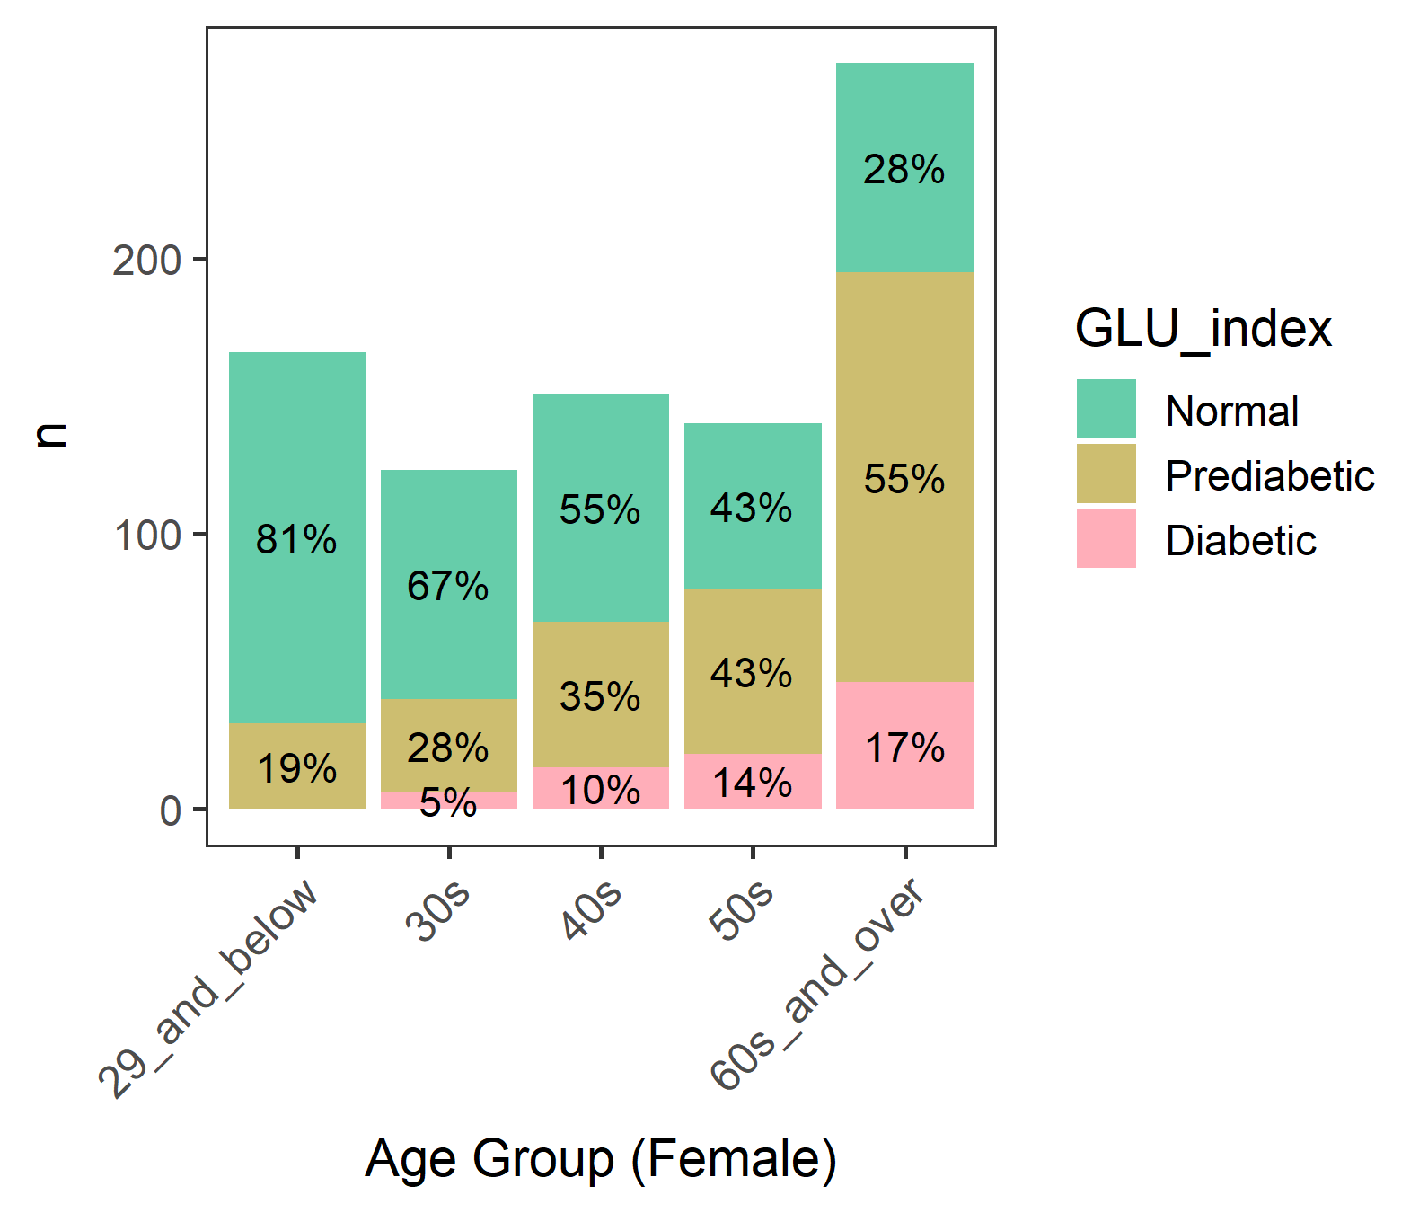
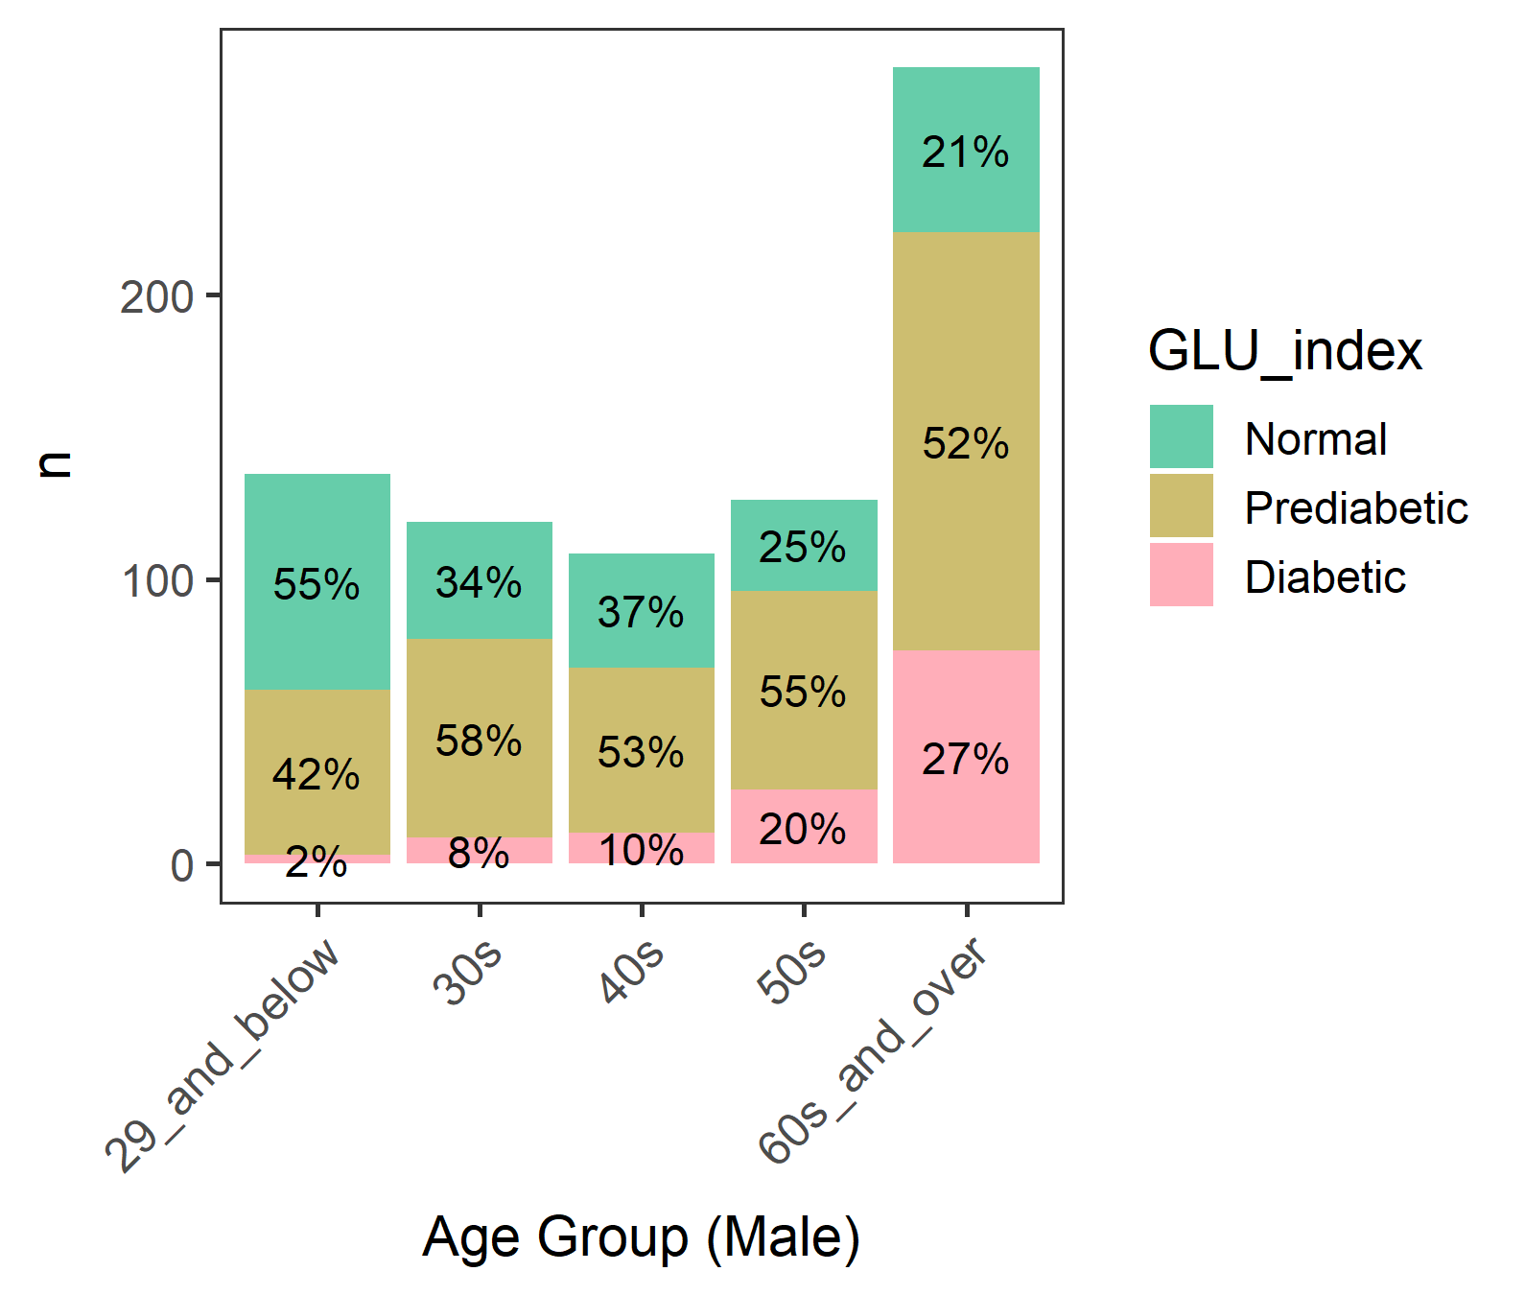
Diabetic groups by gender and age
We focused on male >= 60 where diabetes is most common

Slide 4
Male - Diabetic groups by age
A lot of 80 year-olds. Perhaps 80 or older were grouped.
(Age) 60 61 62 63 64 65 66 67 68 69 70 71 72 73 74 75 76 77 78 79 80
(n) 17 22 14 12 13 17 14 11 8 13 15 11 11 9 12 11 9 7 6 5 43
80+ may not be eating as freely as others due to nursing homes or meal assistance.
But their Normal/Prediabetic/Diabetics percentages are similar to other ages, so should be OK…

Slide 5
Male in 60 and older (60 plus)

Slide 6
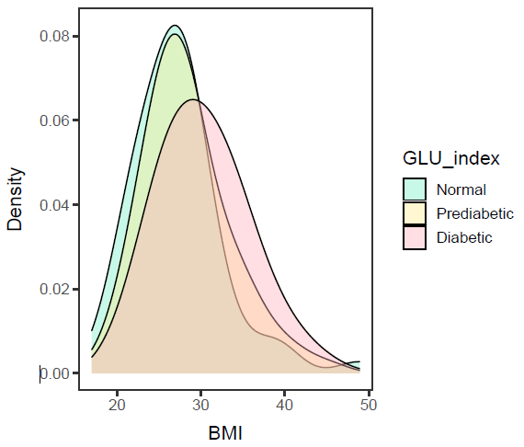
Male in 60 plus, BMI
ANOVA – significant (p-value= 0.0032).
Diabetic is different from Normal and Prediabetic, but
Normal and Prediabetic are not different.
data: df$BMXBMI and df$GLU_index
Normal Prediabetic
Prediabetic 0.1716 -
Diabetic 0.0033 0.0215
Diabetic group has a higher mean BMI than Prediabetic and Normal group.

Slide 7
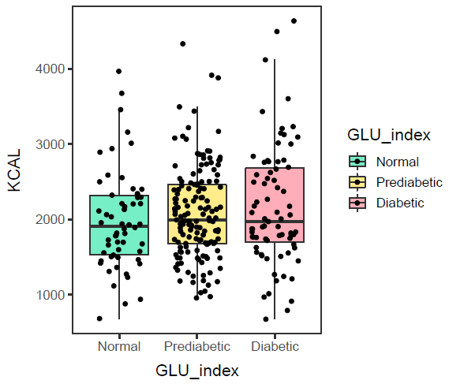
Male in 60 plus, KCAL
ANOVA – not significant (p-value=0.308).
Hmm, so no need to control KCAL intake.
Calorie intake of Normal, Prediabetic, and Diabetic groups are not different.

Slide 8
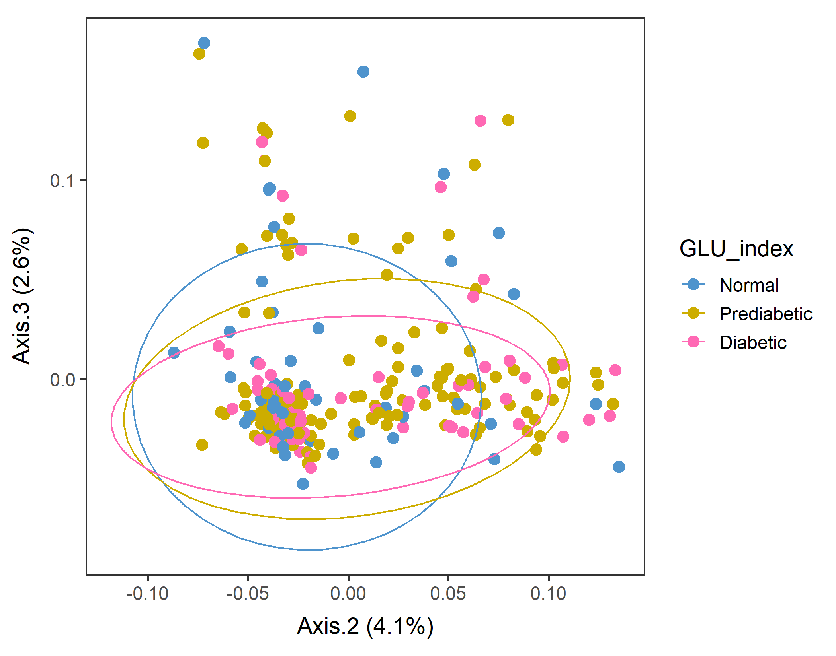
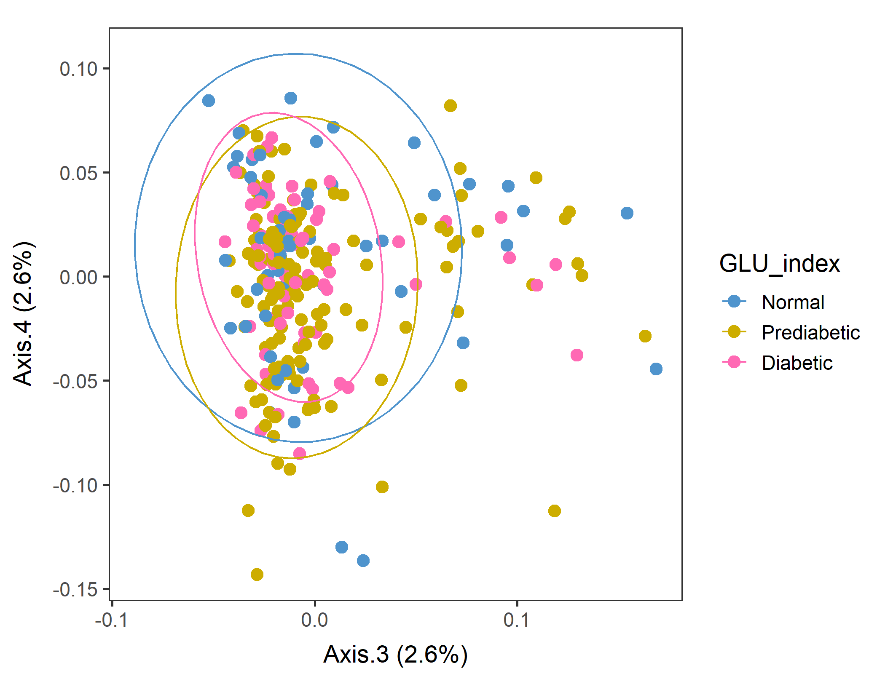
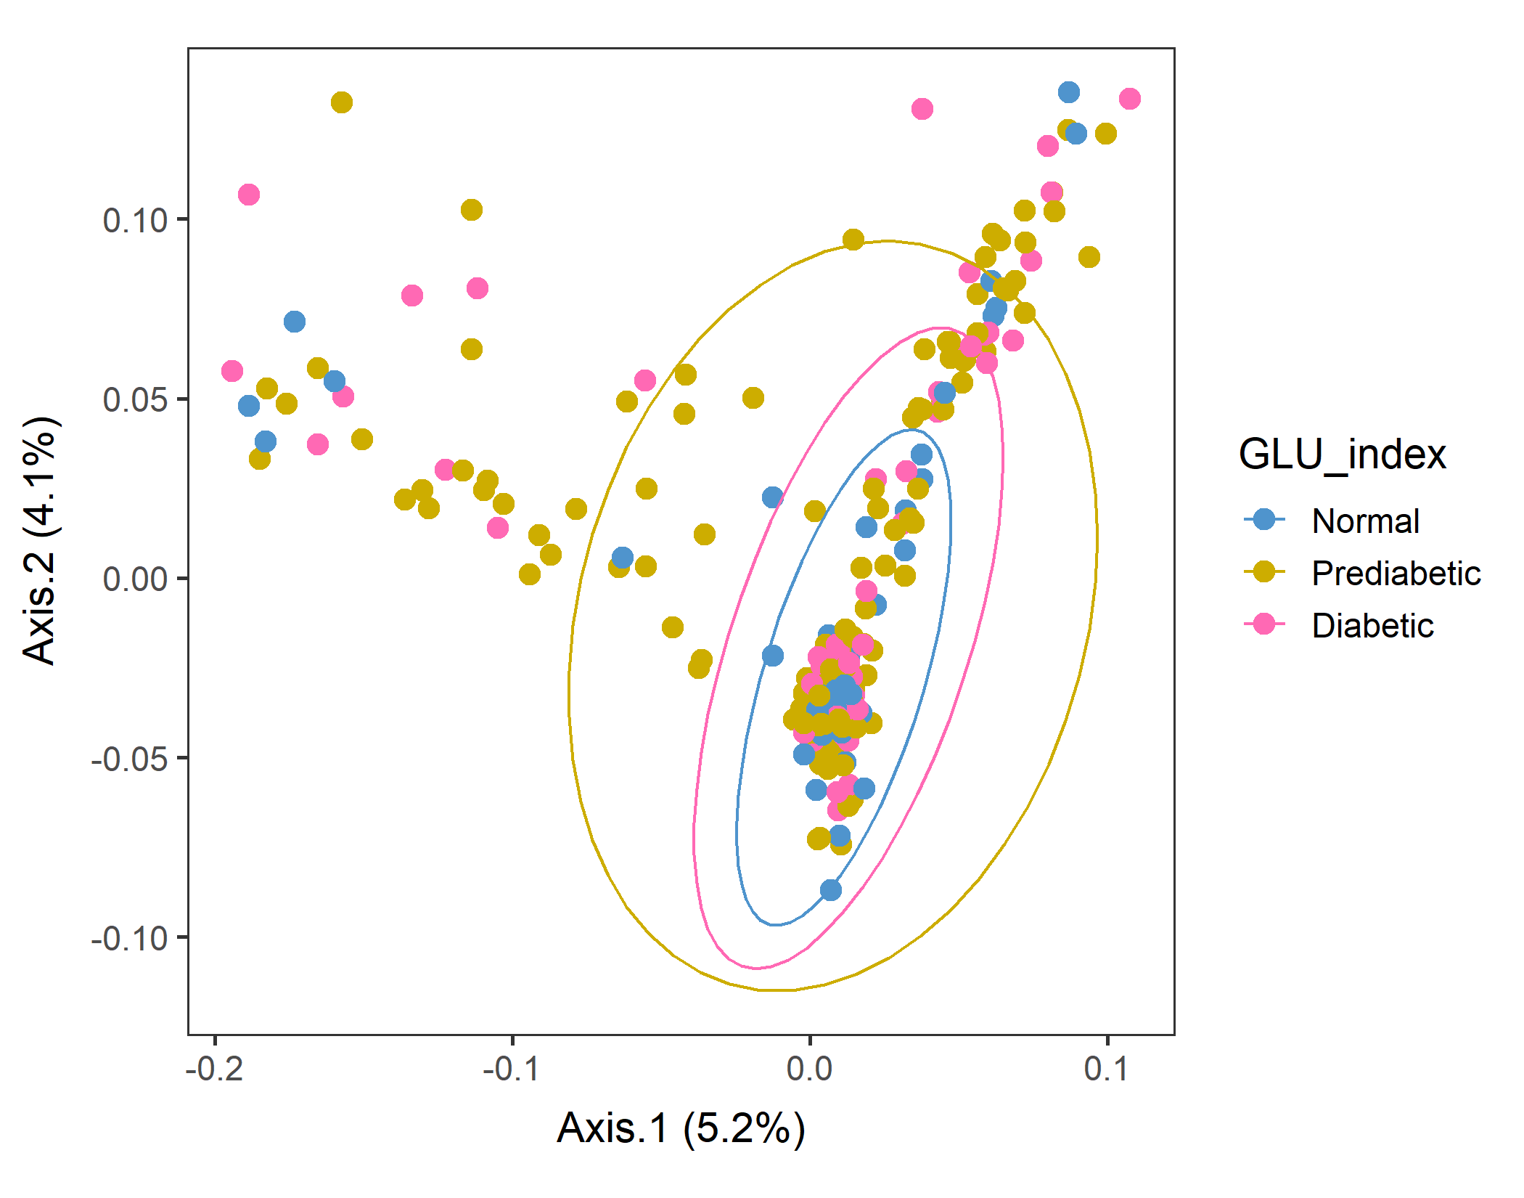
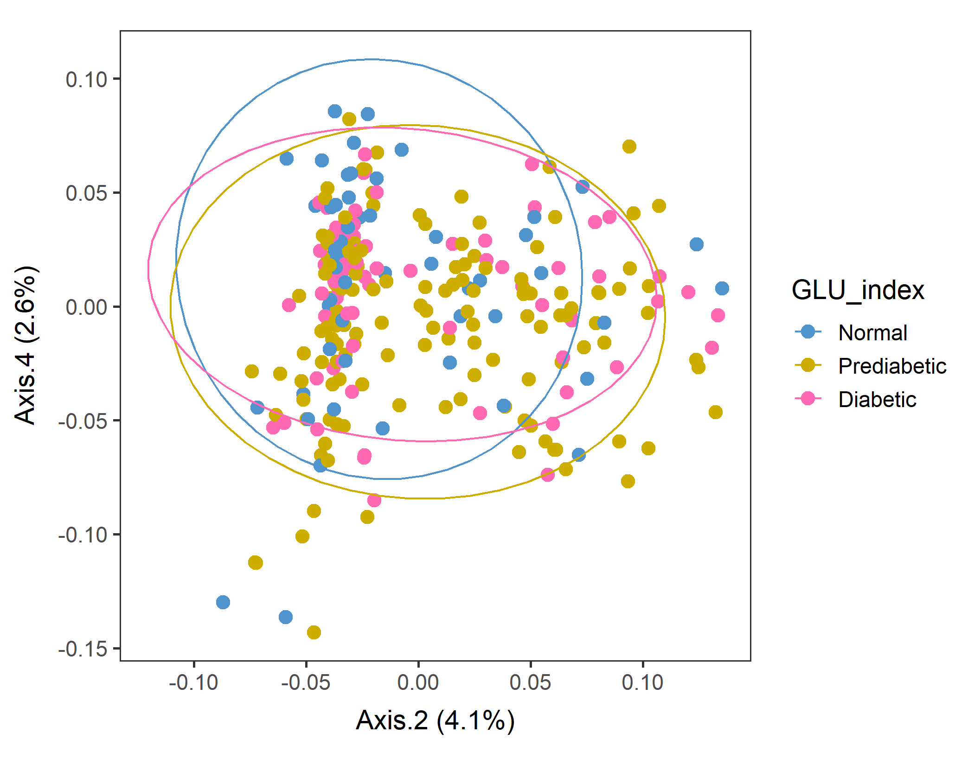
Male in 60plus Lv2 WEIGHTED
In Axes 2&3 and Axes2&4, Normal subpopulations look distinct.
Conversion failed
vegan::permutest: p-value ~0.15. Assumption OK.
vegan::adonis: p-value 0.04. Groups are different.
But pairwise.adonis not significant for any pair.

Slide 9
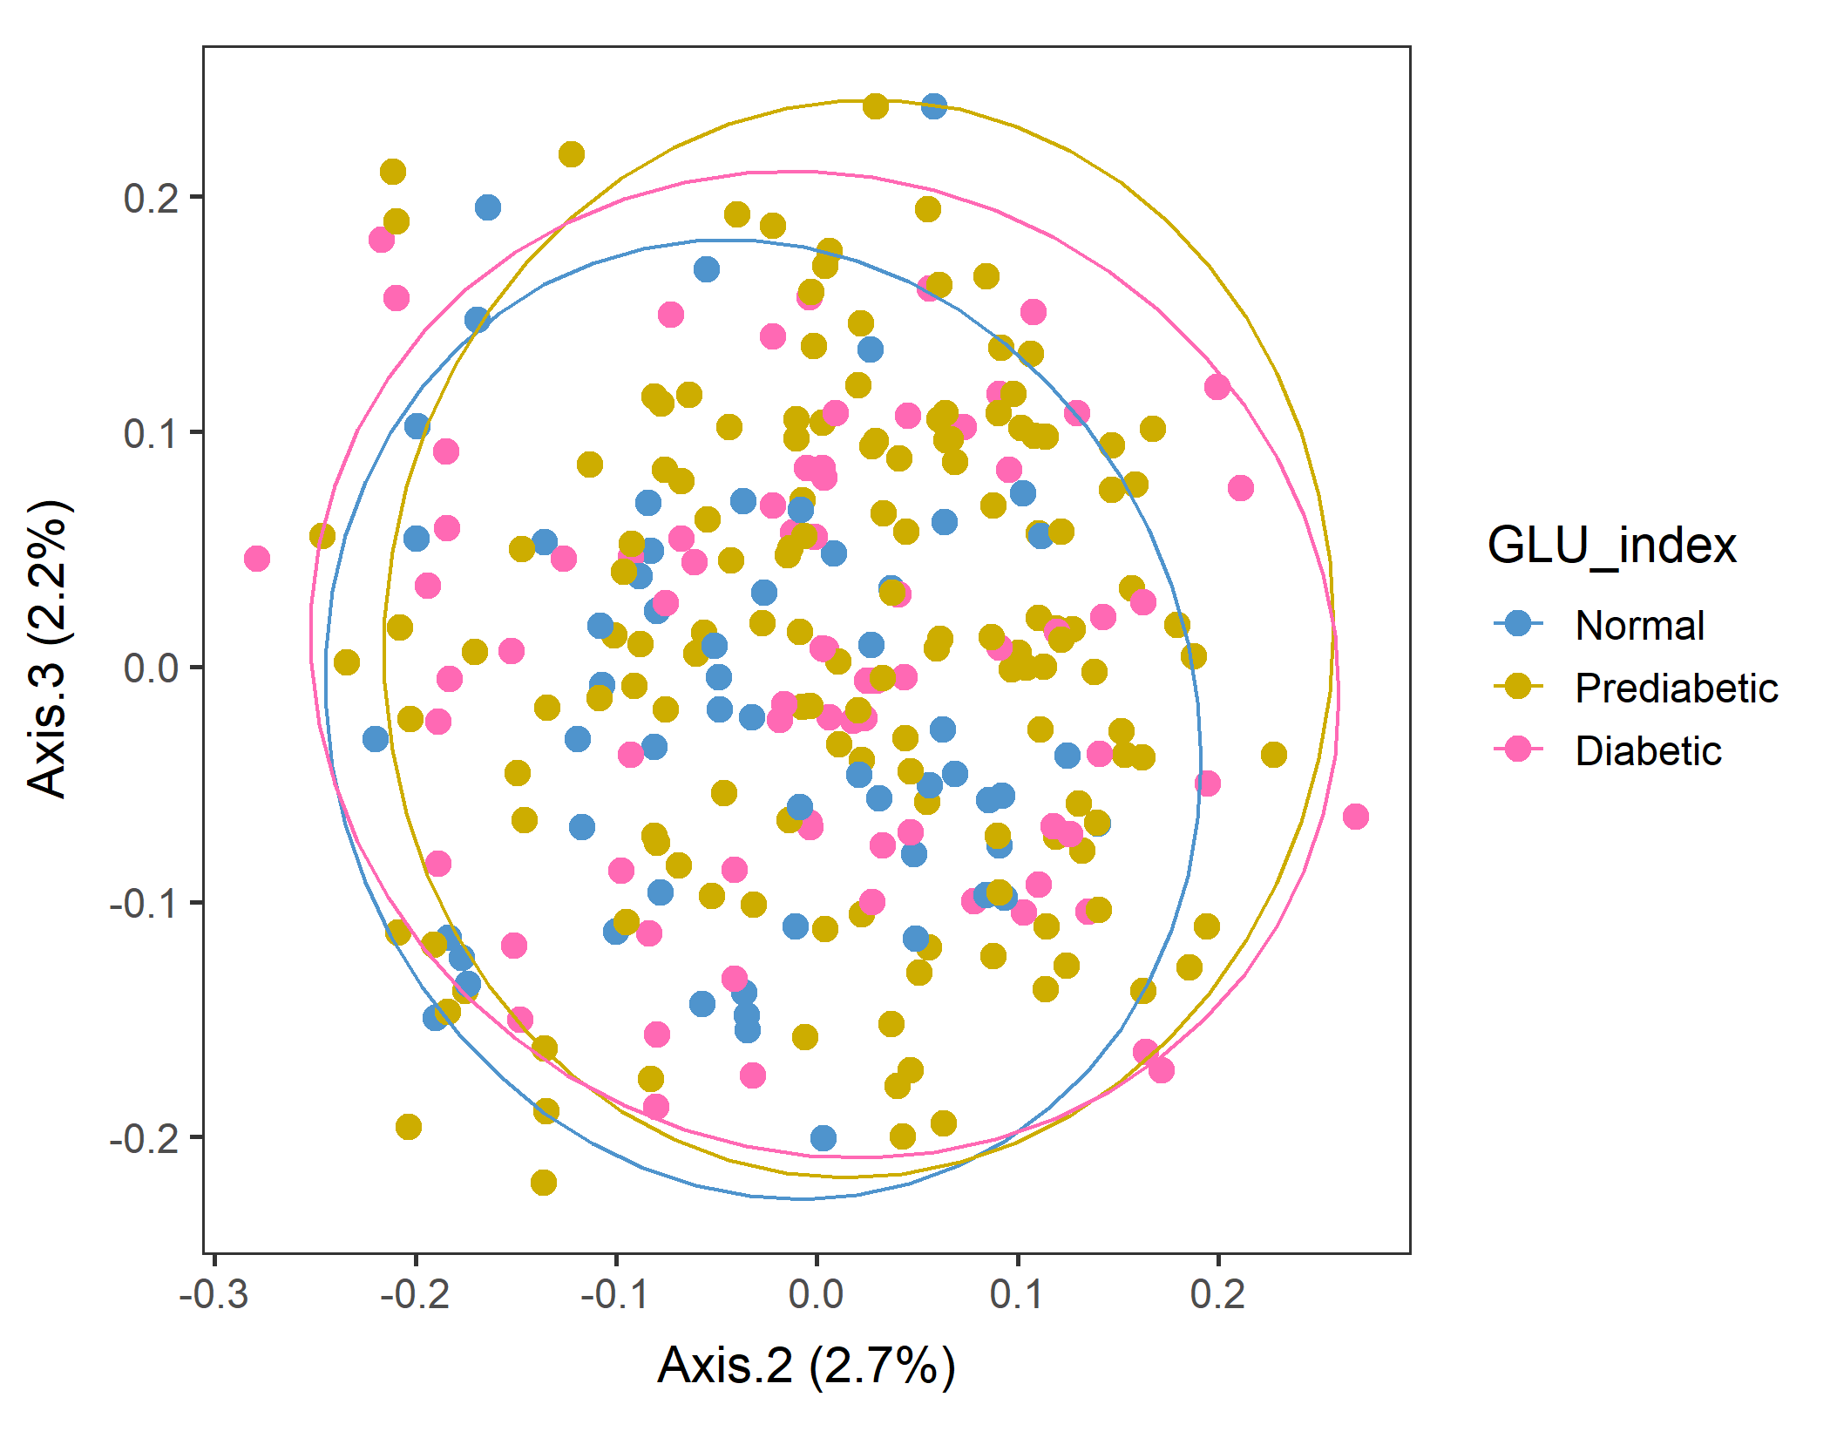
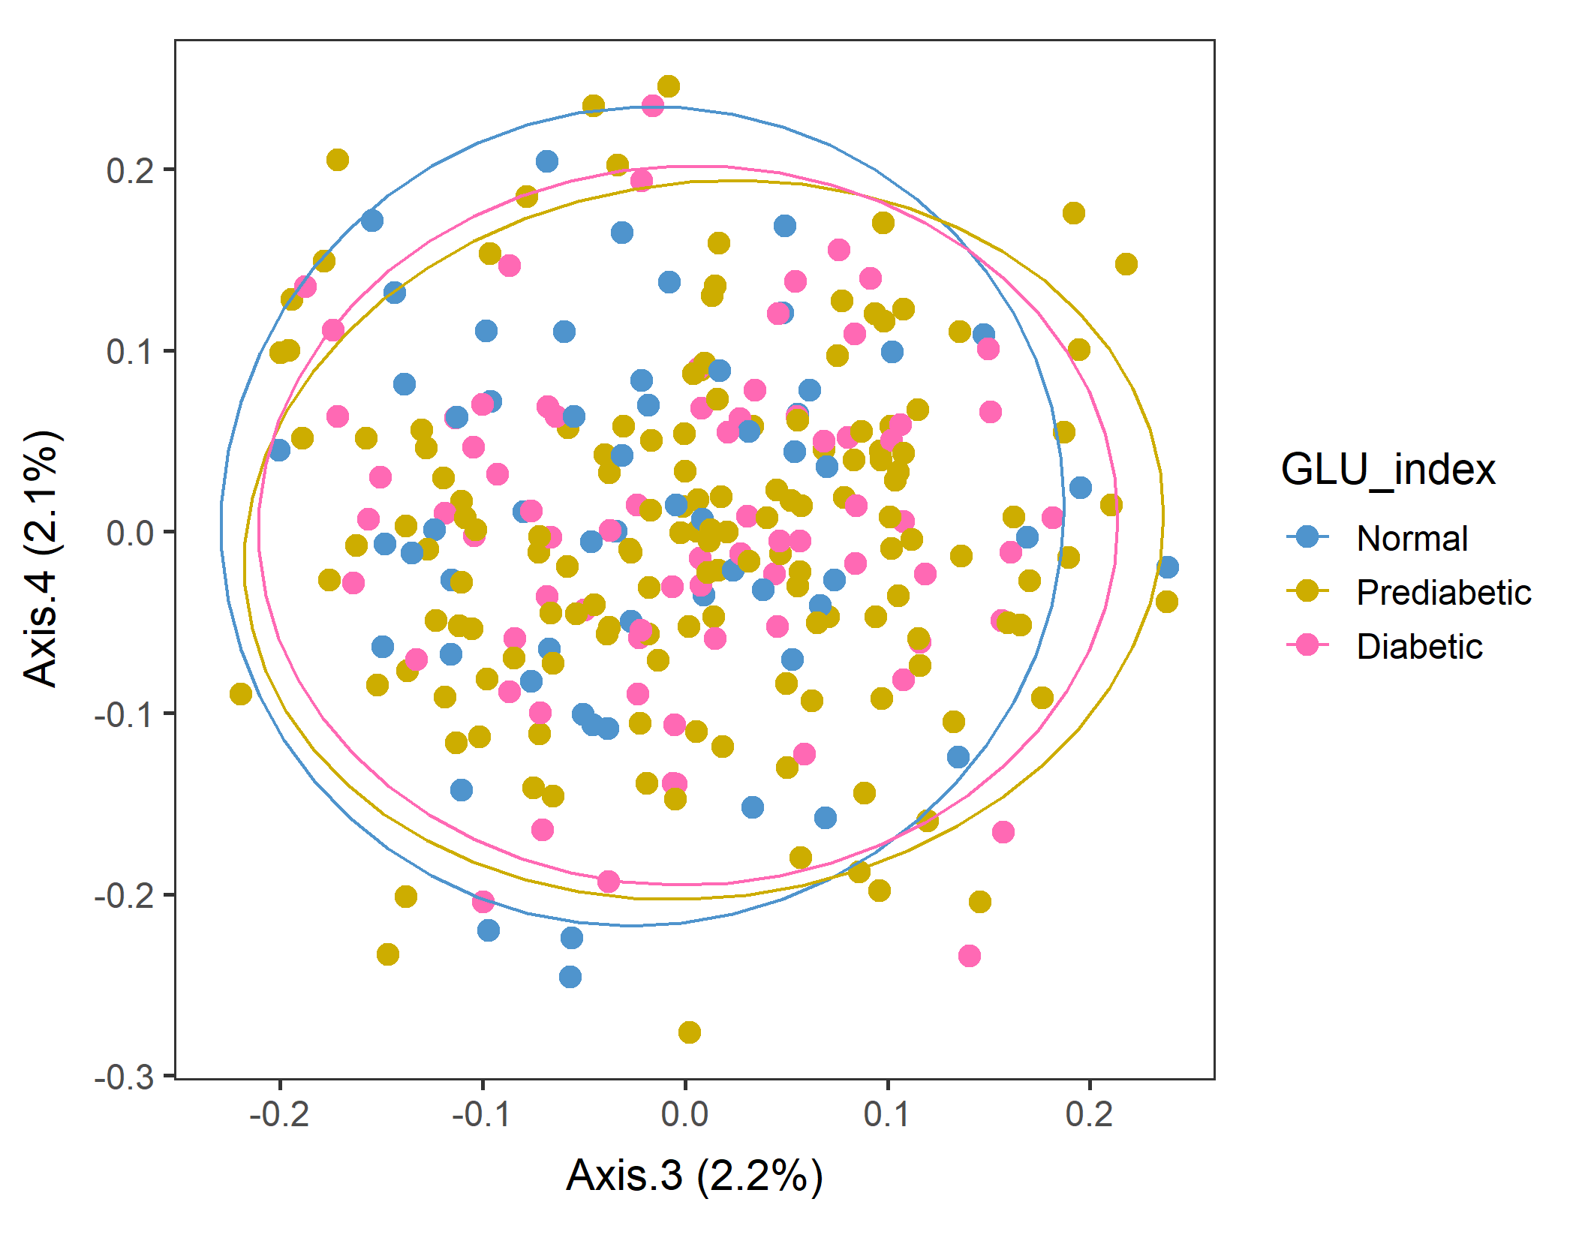
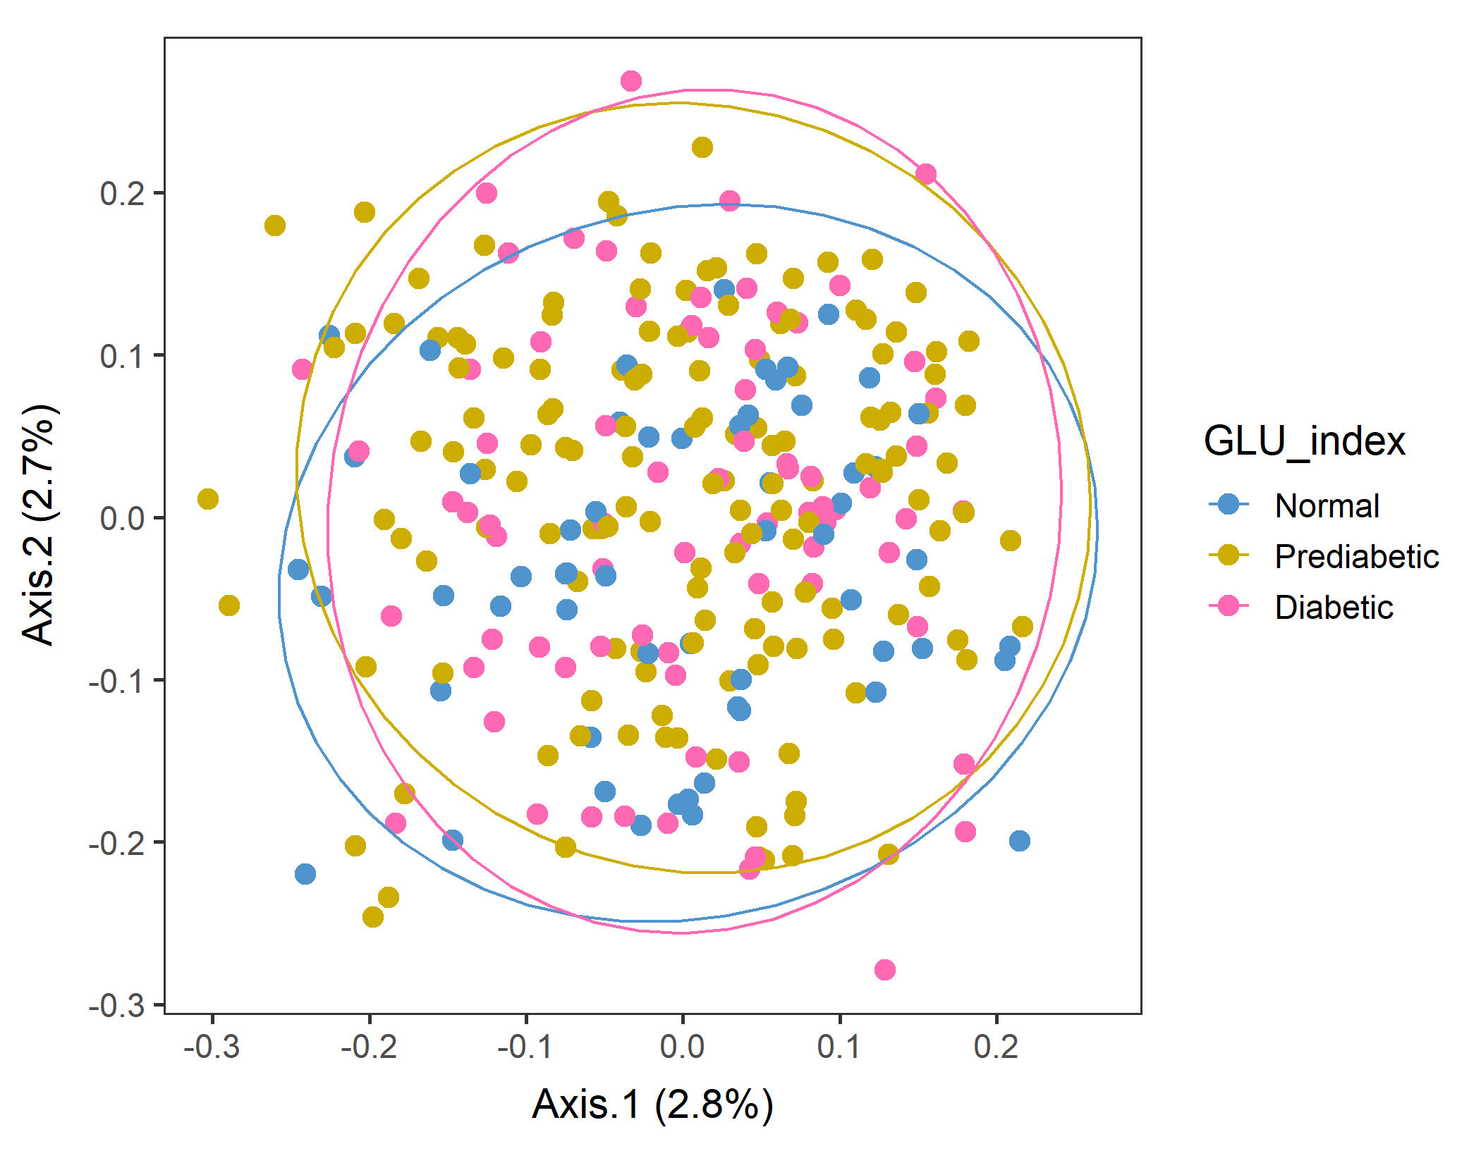
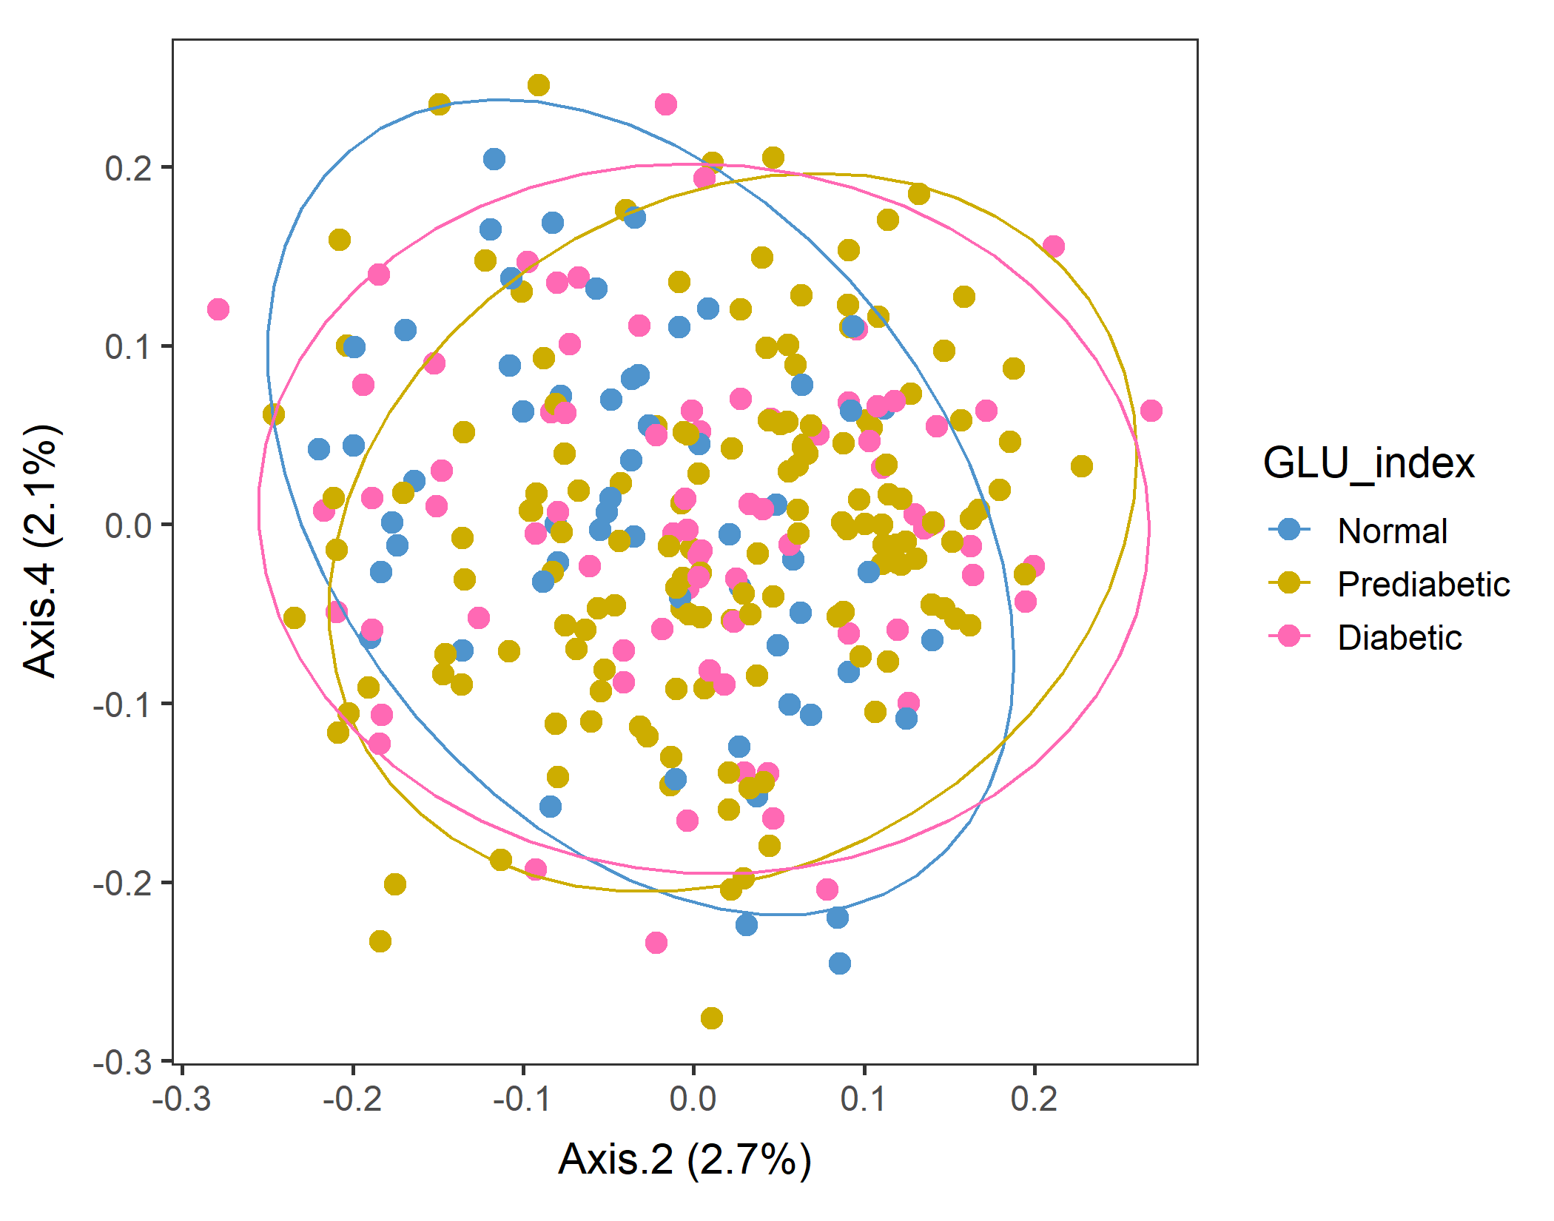
Male in 60plus Lv2 UNweighted
Axes 1&2
vegan::permutest: p-value ~0.8. Assumption OK.
vegan::adonis: p-value:0.013. Groups are different.
But pairwise.adonis not significant for any pair.

Slide 10
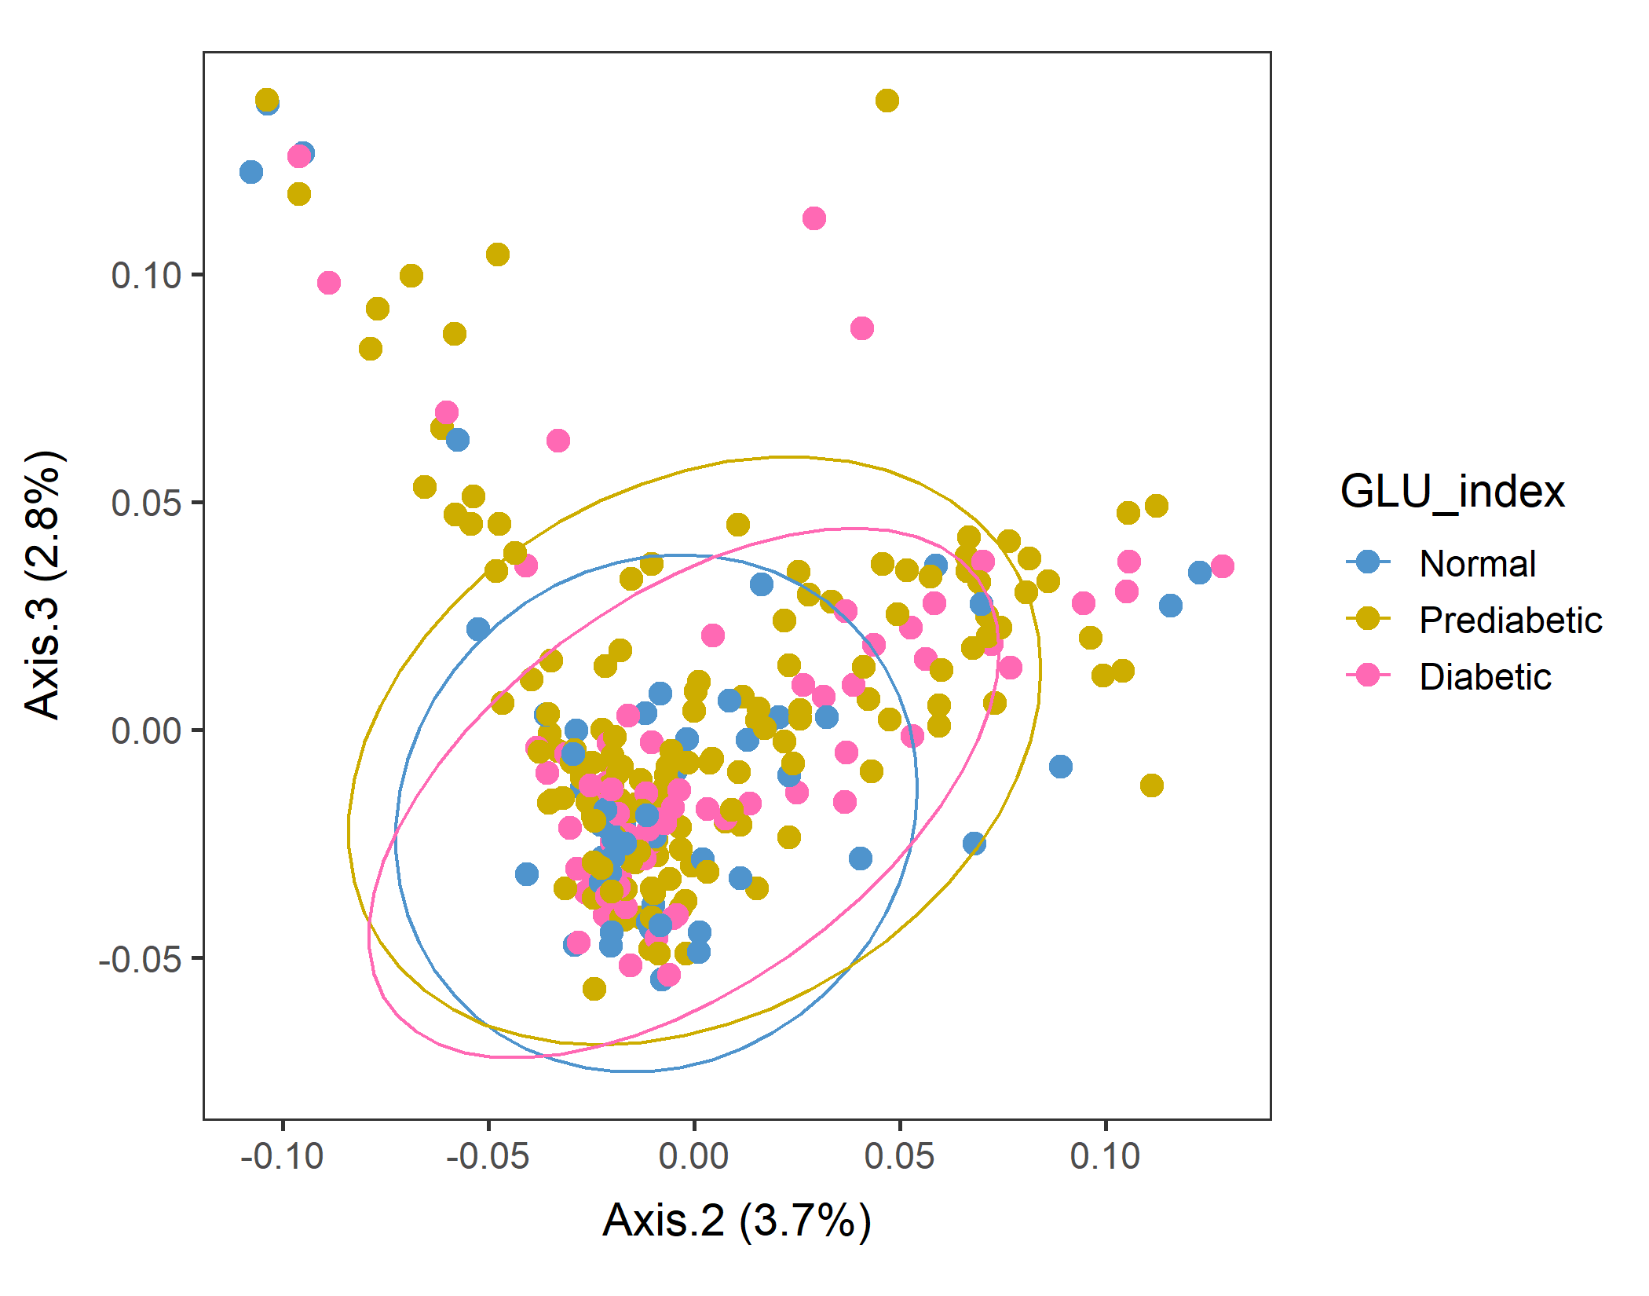
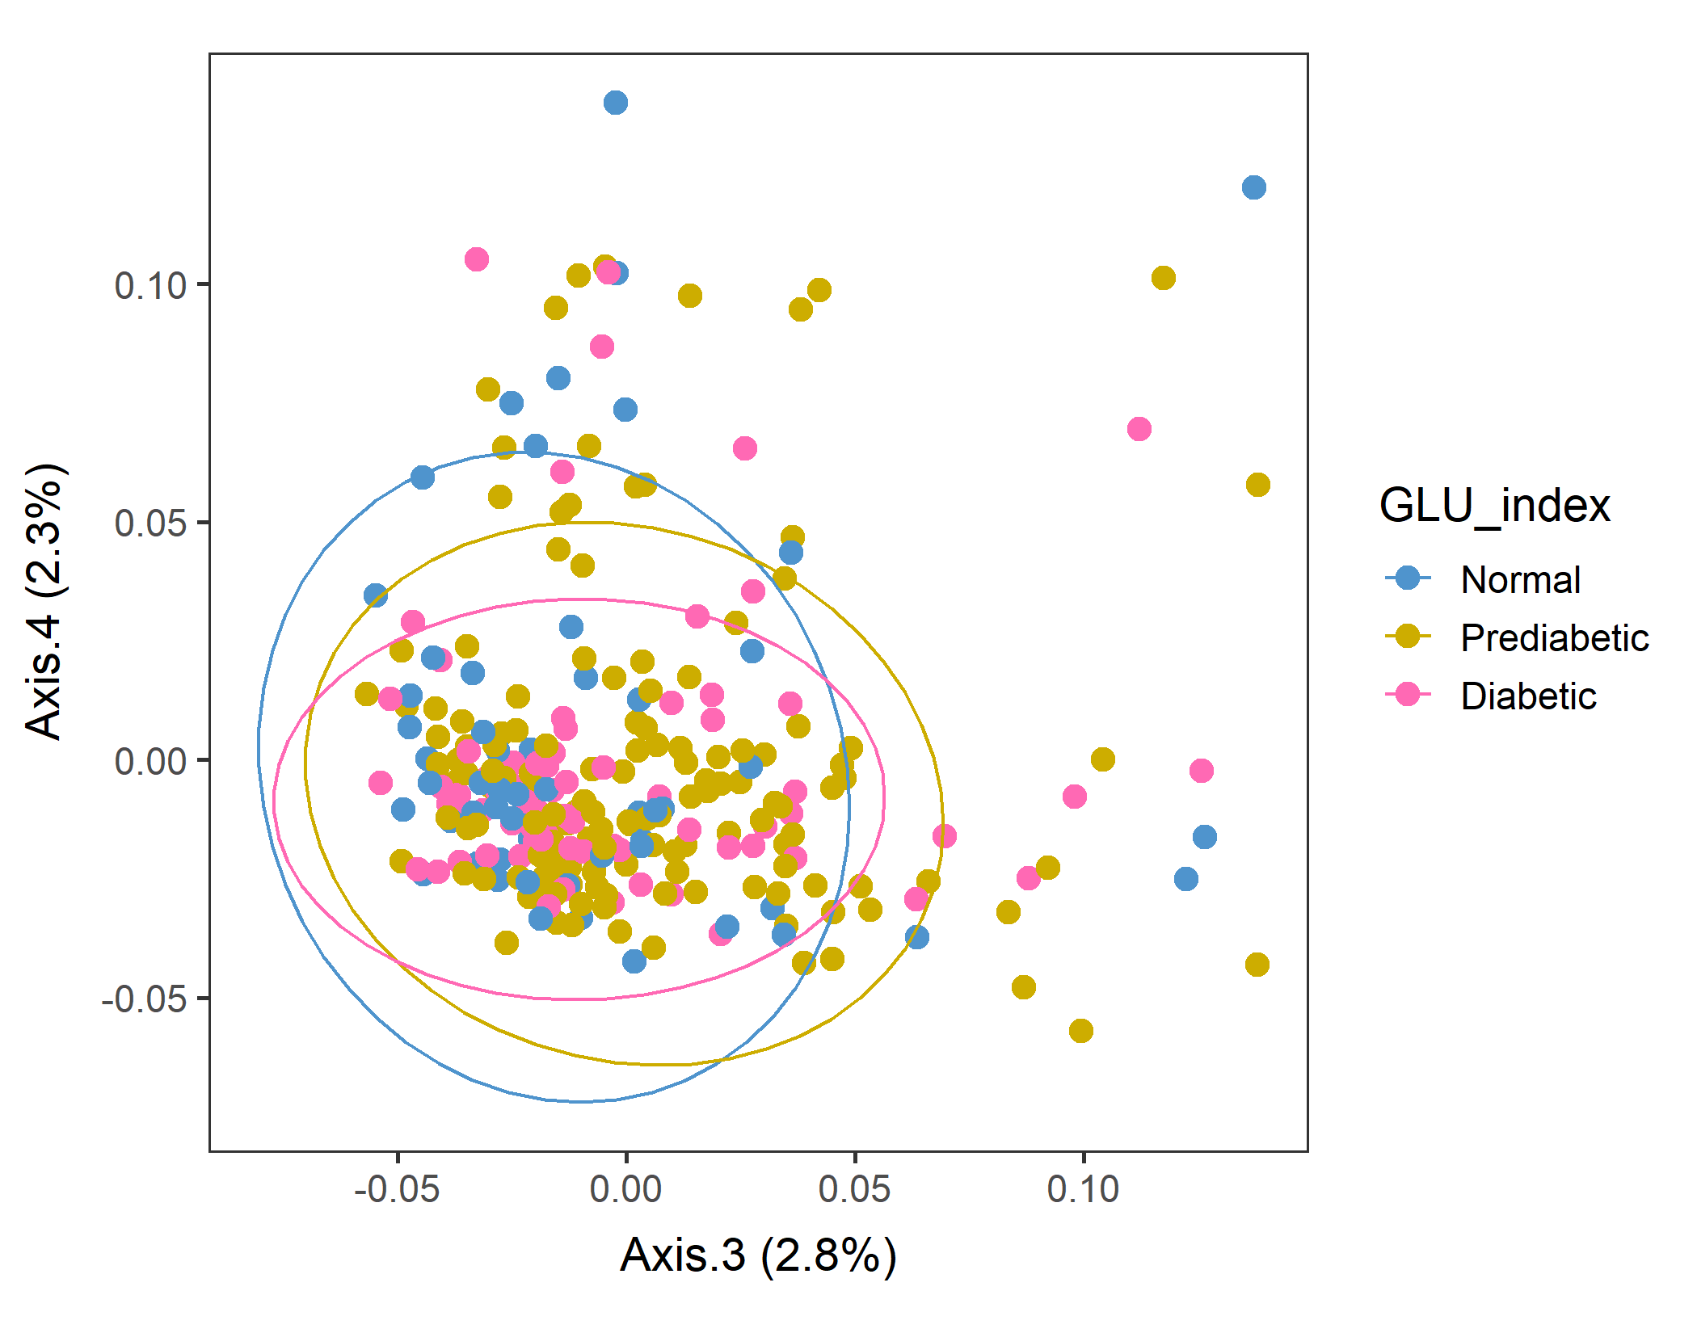
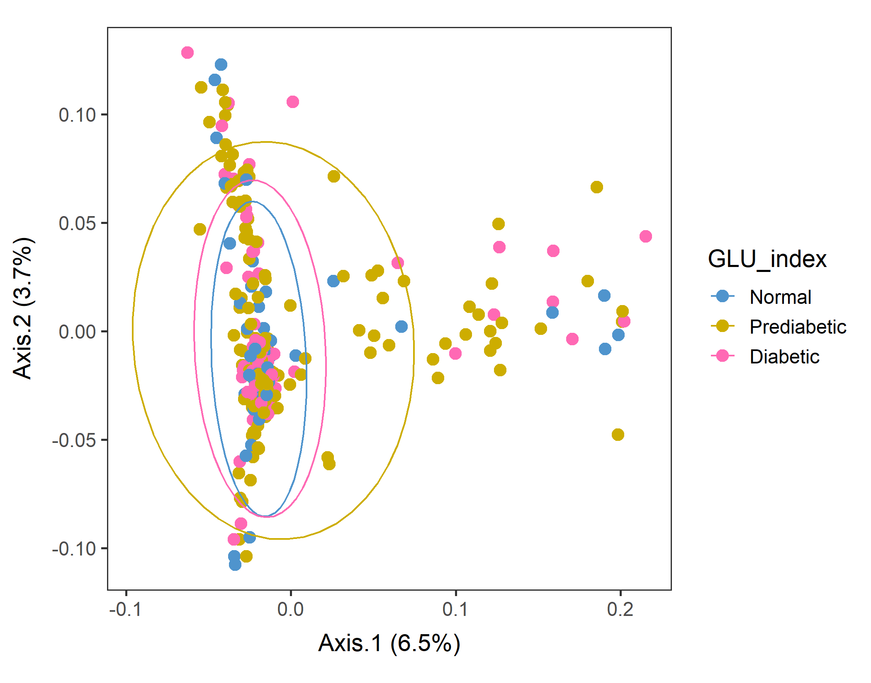
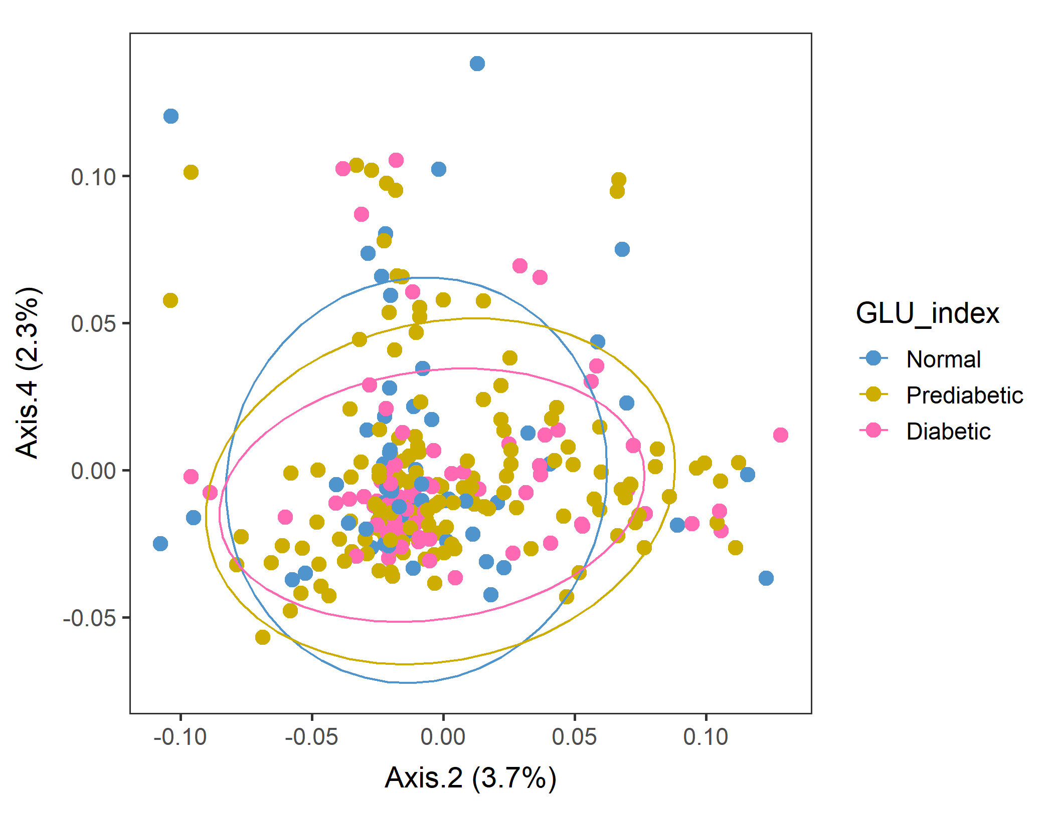
Male in 60plus Lv3 WEIGHTED
Conversion failed
vegan::permutest: p-value ~0.18. Assumption OK.
vegan::adonis: p-value 0.06. Groups are borderline but not different.
Not supposed to do this, but run pairwise adonis (with correct the sample order!). Prediabetic vs Normal are different (p=0.034) but other pairs are not.

Slide 11
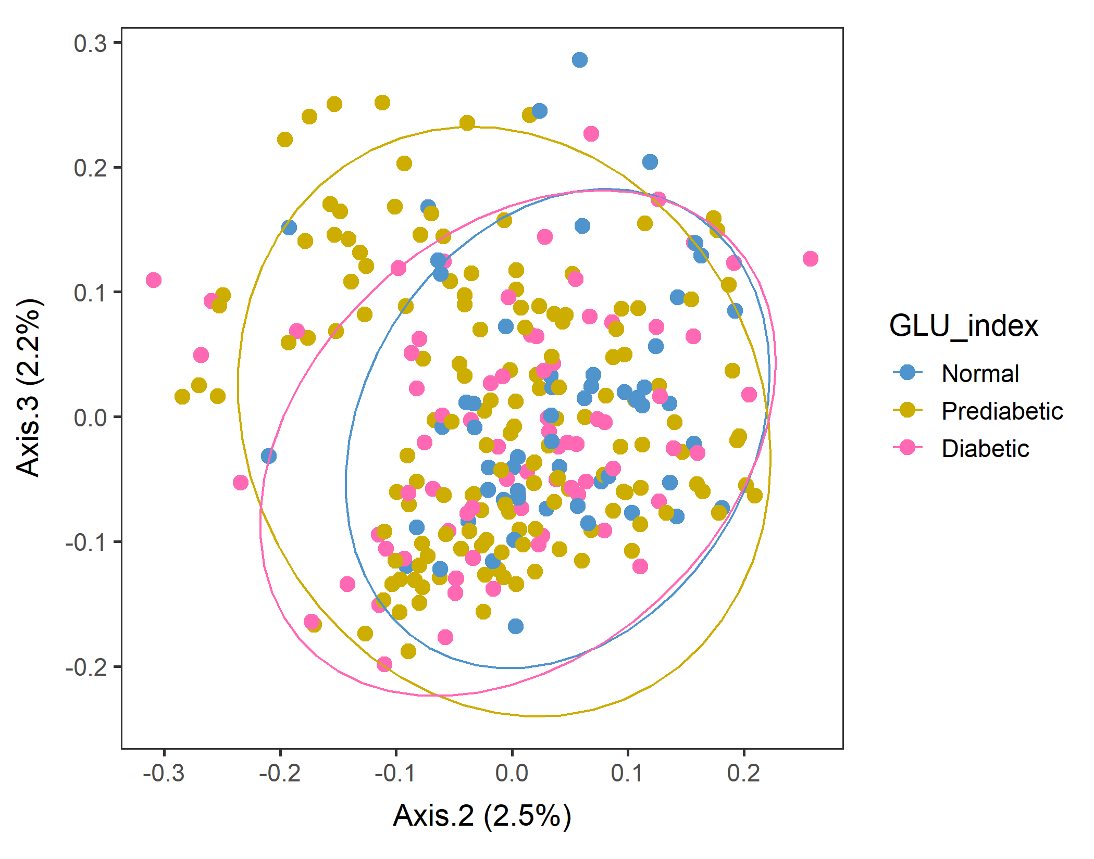
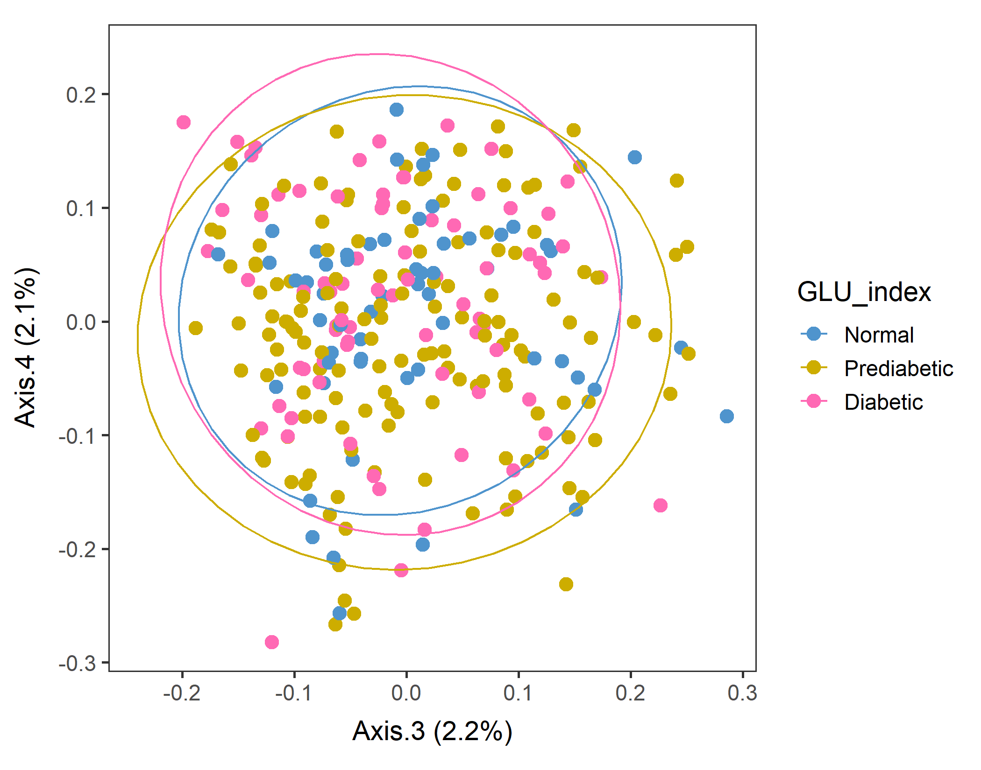
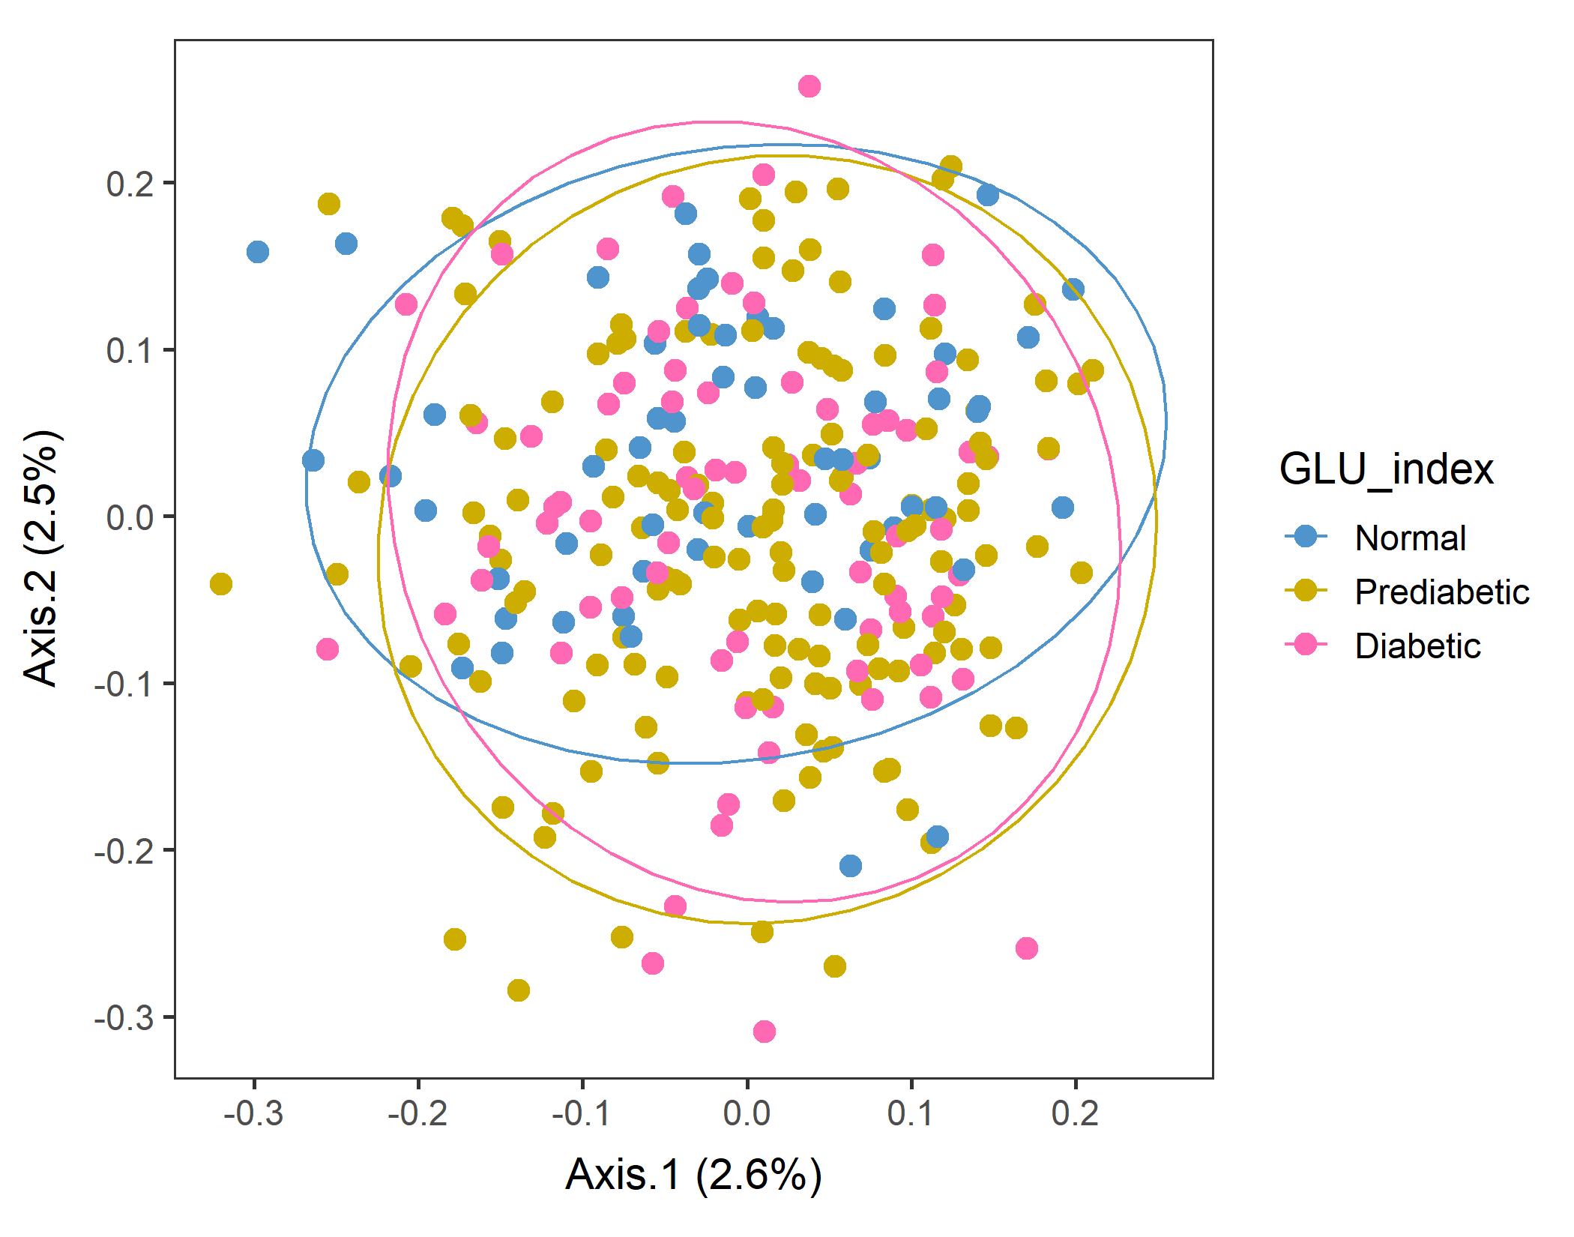
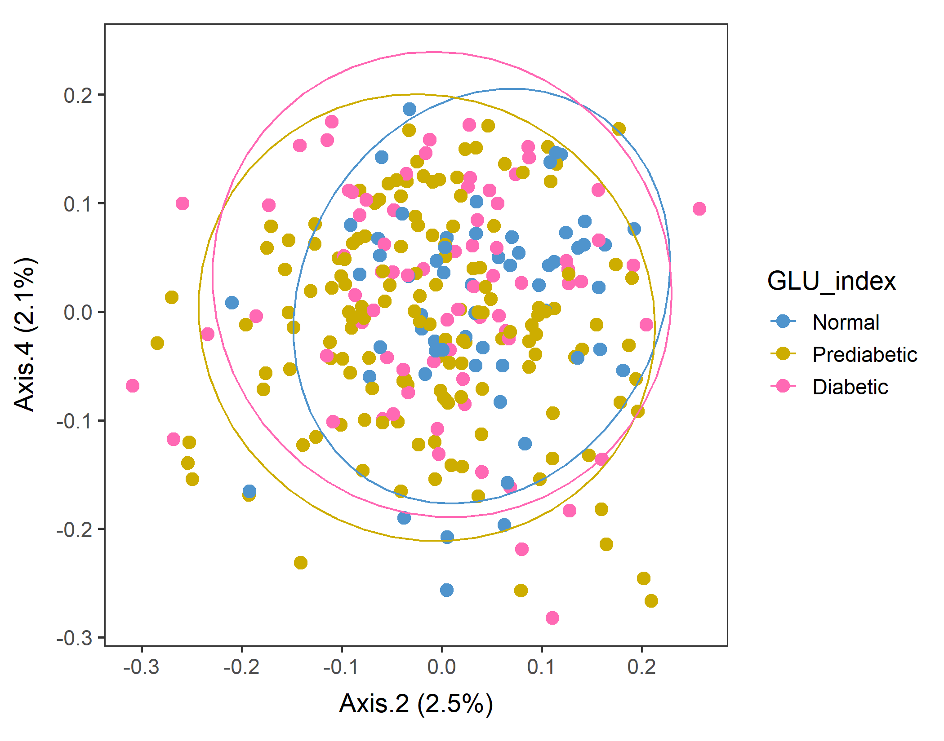
Male in 60plus Lv3 UNweighted
Axes 1&2
vegan::permutest: p-value ~0.86. Assumption OK.
vegan::adonis: p-value:0.007. Groups are different.
Run pairwise adonis (with correct the sample order!). Prediabetic vs Normal are different (p=0.006) but other pairs are not.

Slide 12
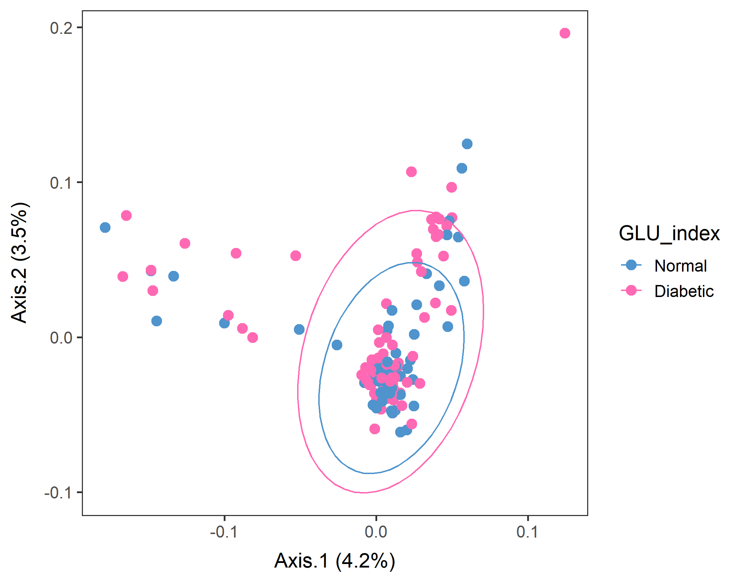
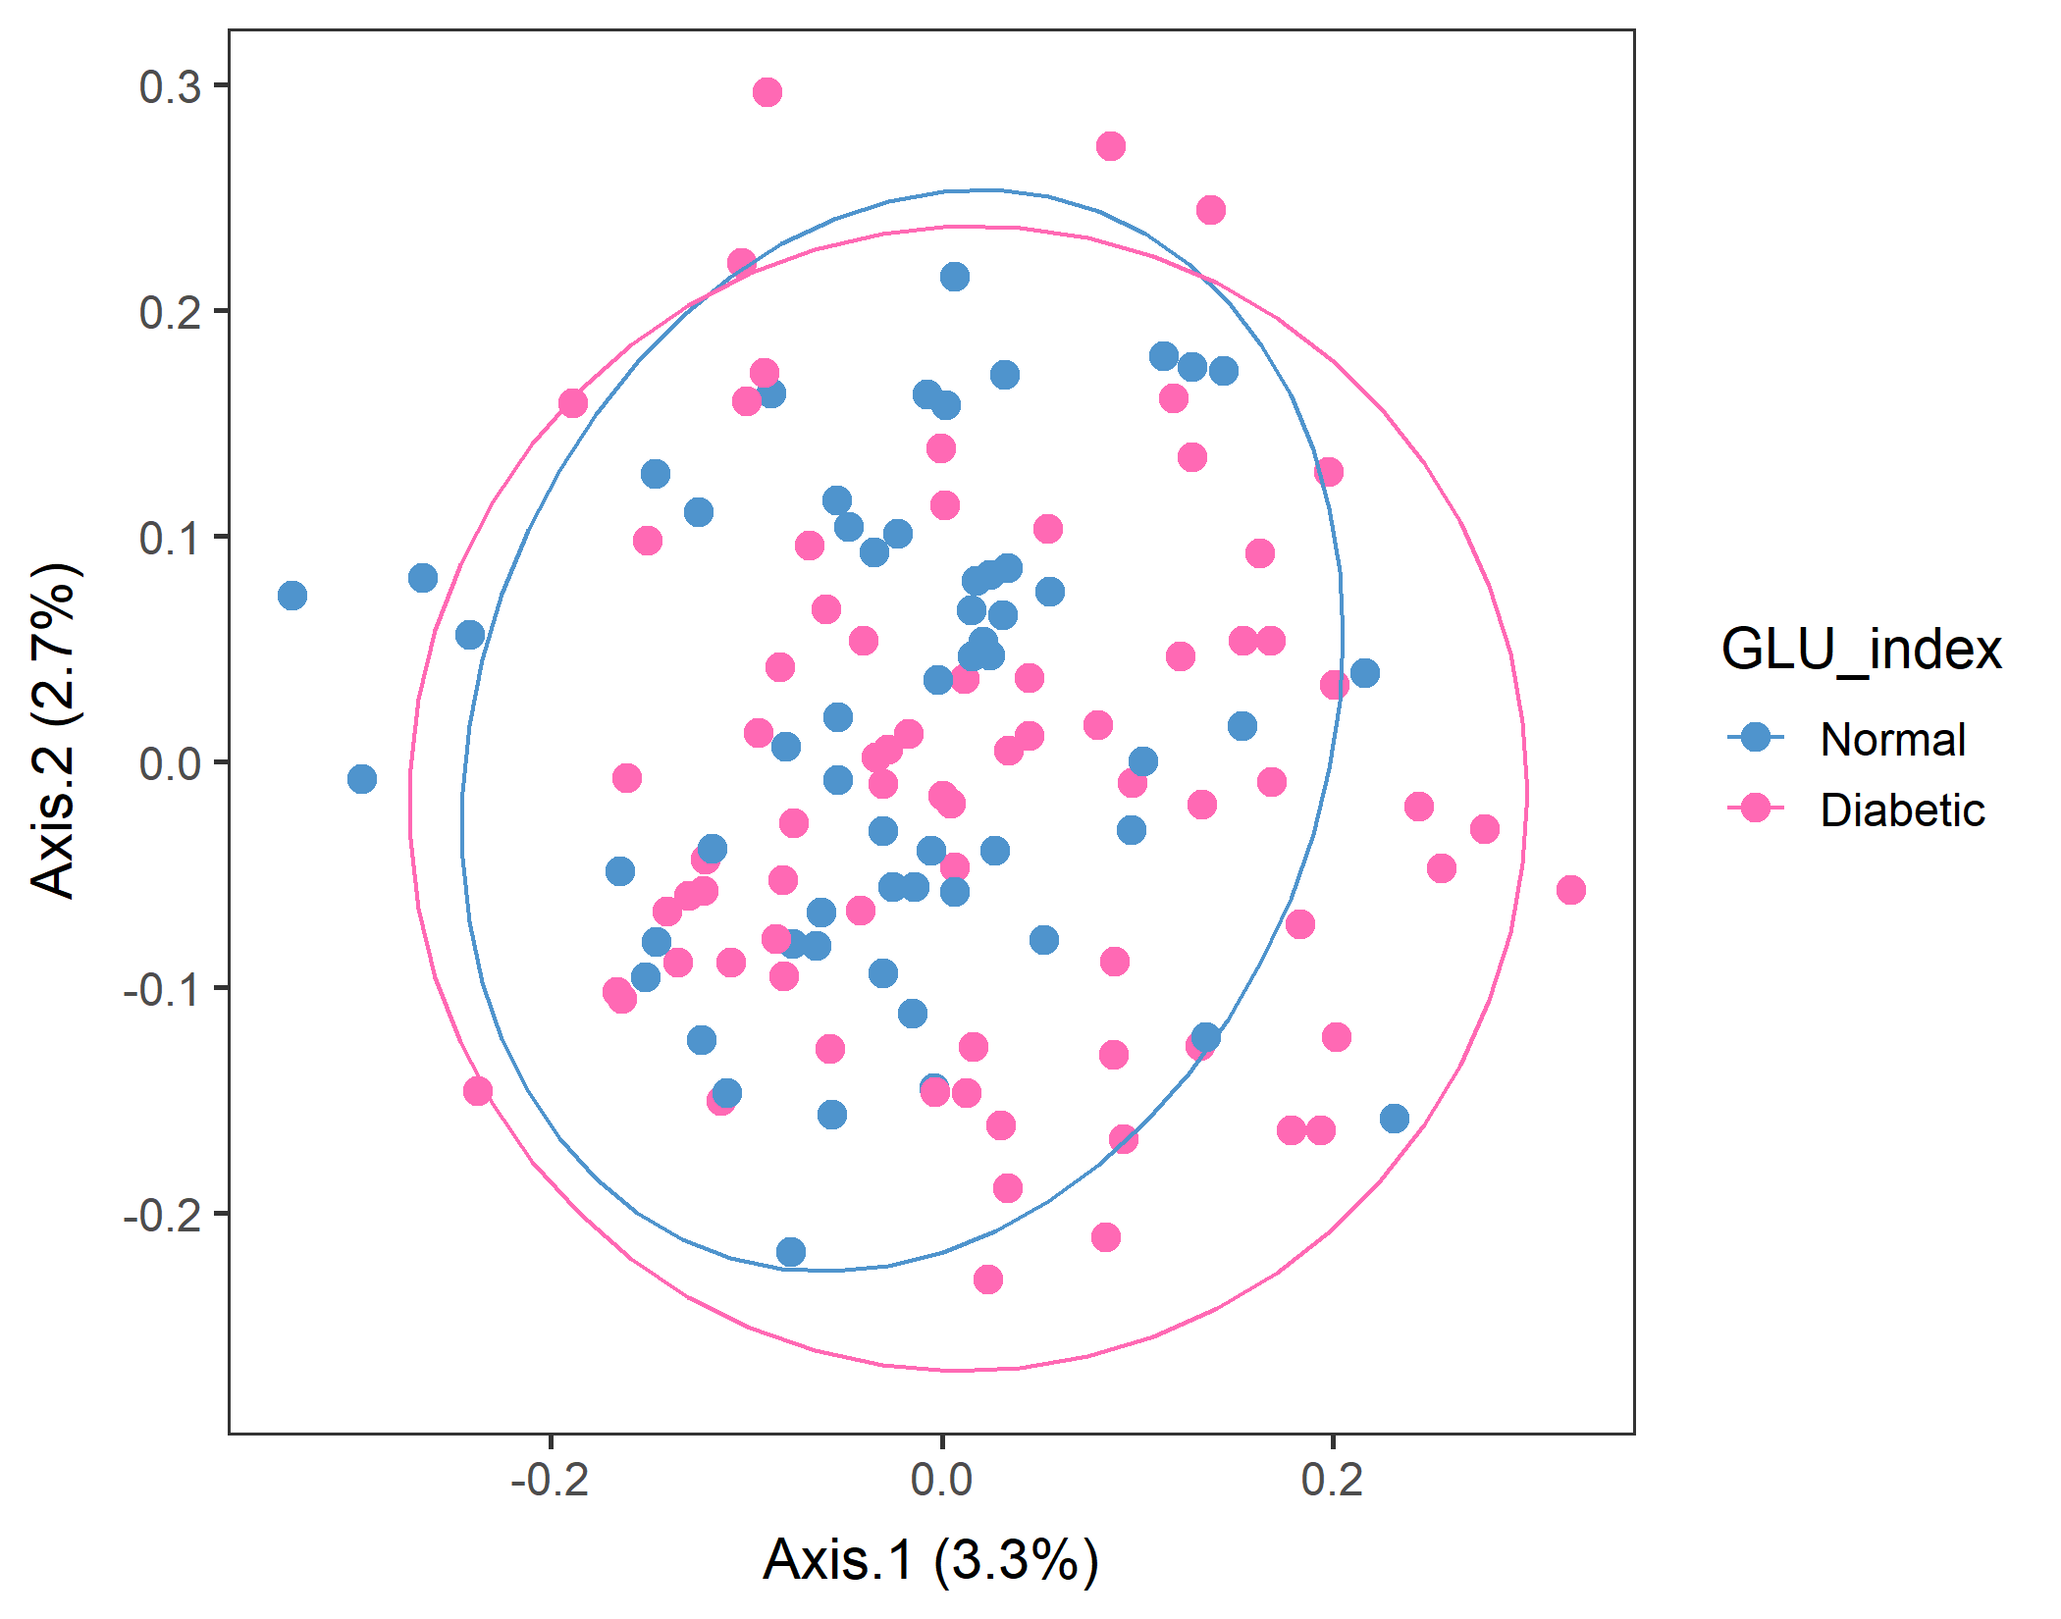
If you just subset Normal and Diabetic, is there a difference between them?
WEIGHTED
vegan::permutest: p-value ~0.15. Assumption OK.
vegan::adonis: p-value: 0.06. Groups are still borderline..
Pairwise adonis should return the same results as overall adonis because there are only two groups. And it did with a similar p-value.
UNweighted
vegan::permutest: p-value ~0.6. Assumption OK.
vegan::adonis: p-value:0.04. Groups are different..
Pairwise adonis should return the same results as overall adonis because there are only two groups. And it did with a similar p-value.
Should look at Normal vs. Prediabetic.

Slide 13
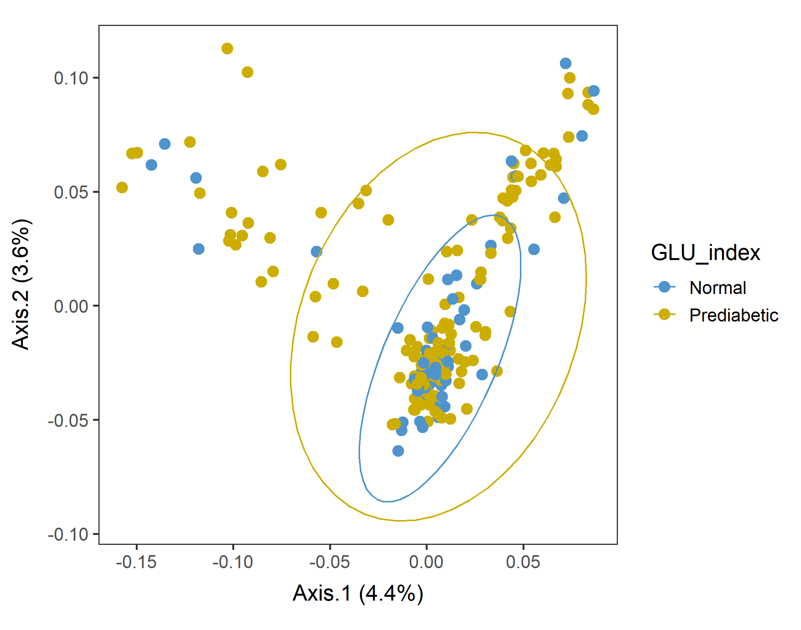
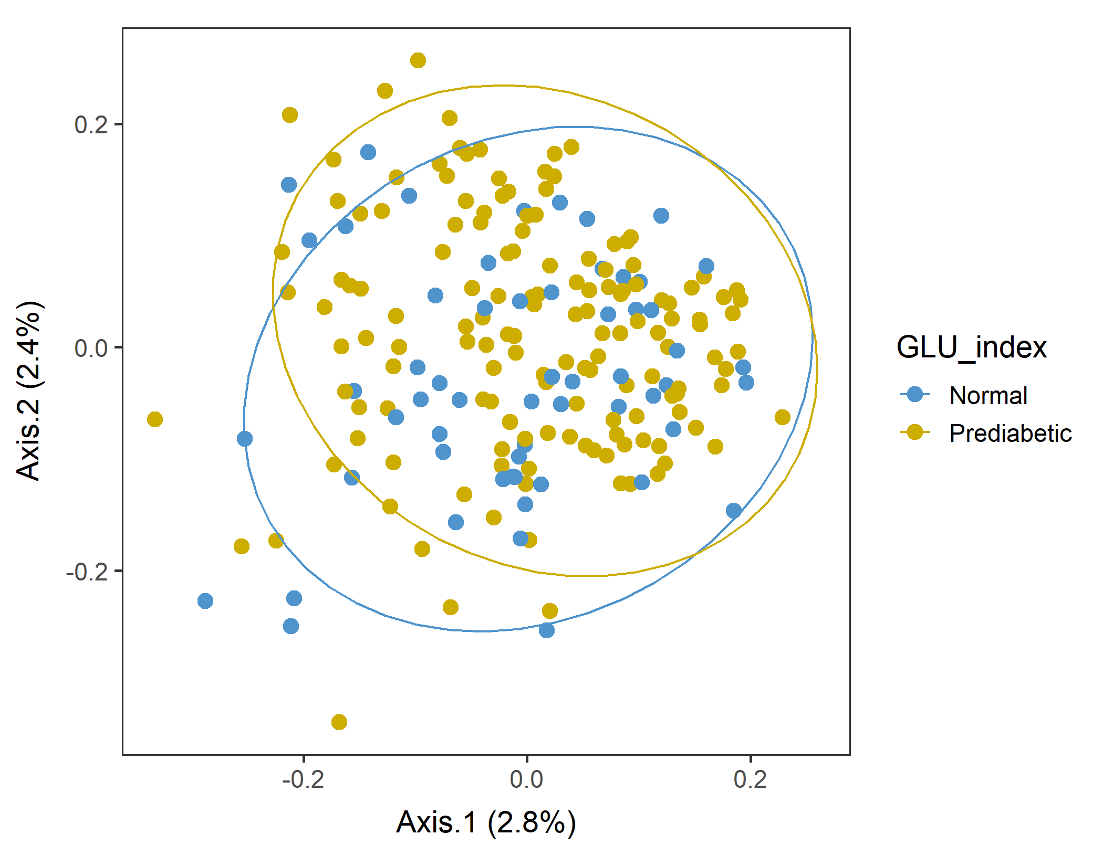
If you just subset Normal and Prediabetic, is there a difference between them?
WEIGHTED
vegan::permutest: p-value ~0.5. Assumption OK.
vegan::adonis: p-value: 0.02. Groups are different, as expected.
Pairwise adonis should return the same results as overall adonis because there are only two groups. And it did with a similar p-value.
UNweighted
vegan::permutest: p-value ~0.77. Assumption OK.
vegan::adonis: p-value: ~0.01. Groups are different.
Pairwise adonis should return the same results as overall adonis because there are only two groups. And it did with a similar p-value.
Yes, they are different!

Slide 14
Male in 60plus PCA test separation using adonis by feeding Euclidean distance matrix to the model.
vegan::adonis(DISTANCE_MATRIX, FACTOR, perm=999)
In theory, it can handle any distance matrix, even Euclidean.
Axes 1&2
vegan::permutest: p-value ~.
vegan::adonis: p-value. Groups are.

Slide 15
Corr between food groups and Axes. (heatmap)
Axes 1&2
vegan::permutest: p-value ~. Assumption OK.
vegan::adonis: p-value. Groups are.

Slide 16
title
HT traits
Textbox
Ag traits

Slide 17
Title

Slide 18
Title
Subtitle

Slide 19
Mistake in 40_ordination_NHANES_xxxx found!!
# Convert the GLU_index as a factor to plot it in order.
loaded_glu_u$GLU_index <- factor(loaded_glu_u$GLU_index, labels= c("Normal", "Prediabetic", "Diabetic"))
This must be levels, not labels!!!!
# Change the plot colors so that new figures with correct levels can be distinguished from the incorrect ones…
colors c("turquoise2", "goldenrod3", "mediumvioletred“) --> replaced with c("steelblue3", "gold3", "hotpink“)

Slide 20
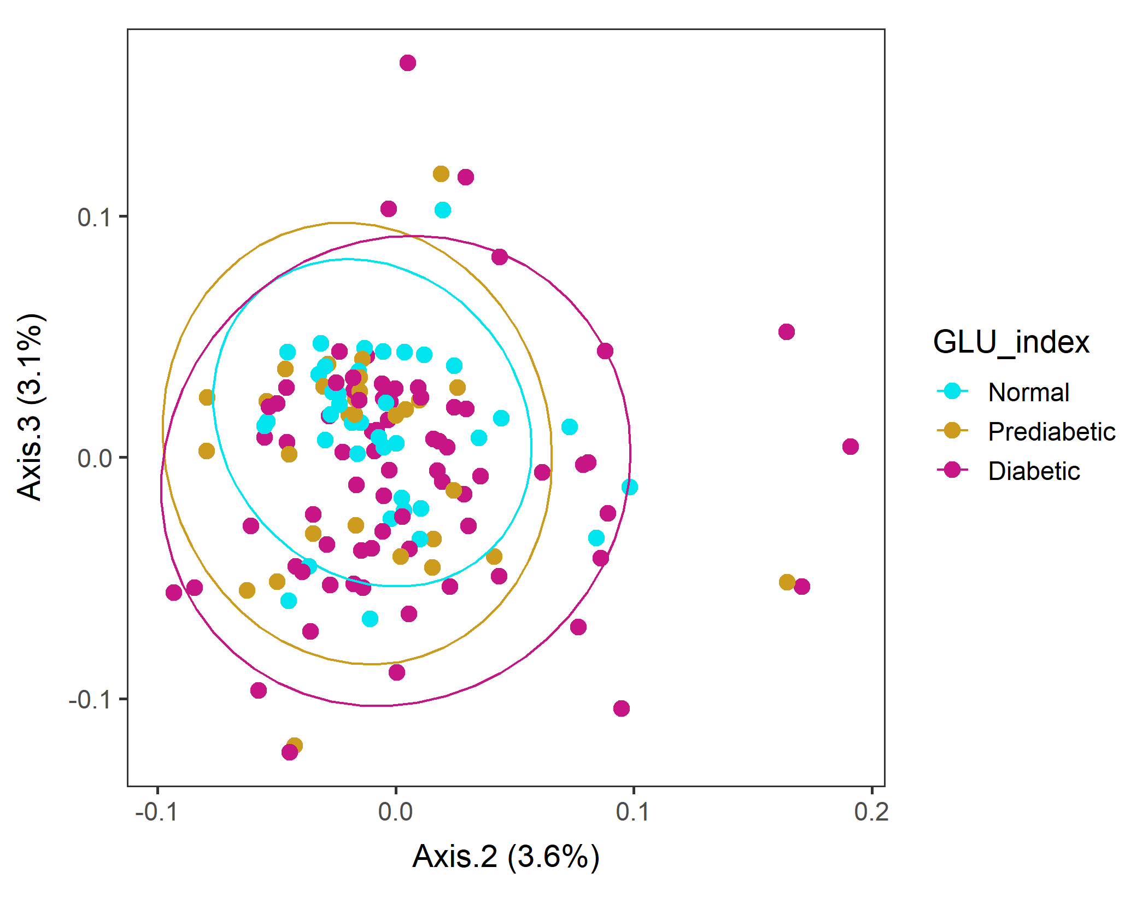
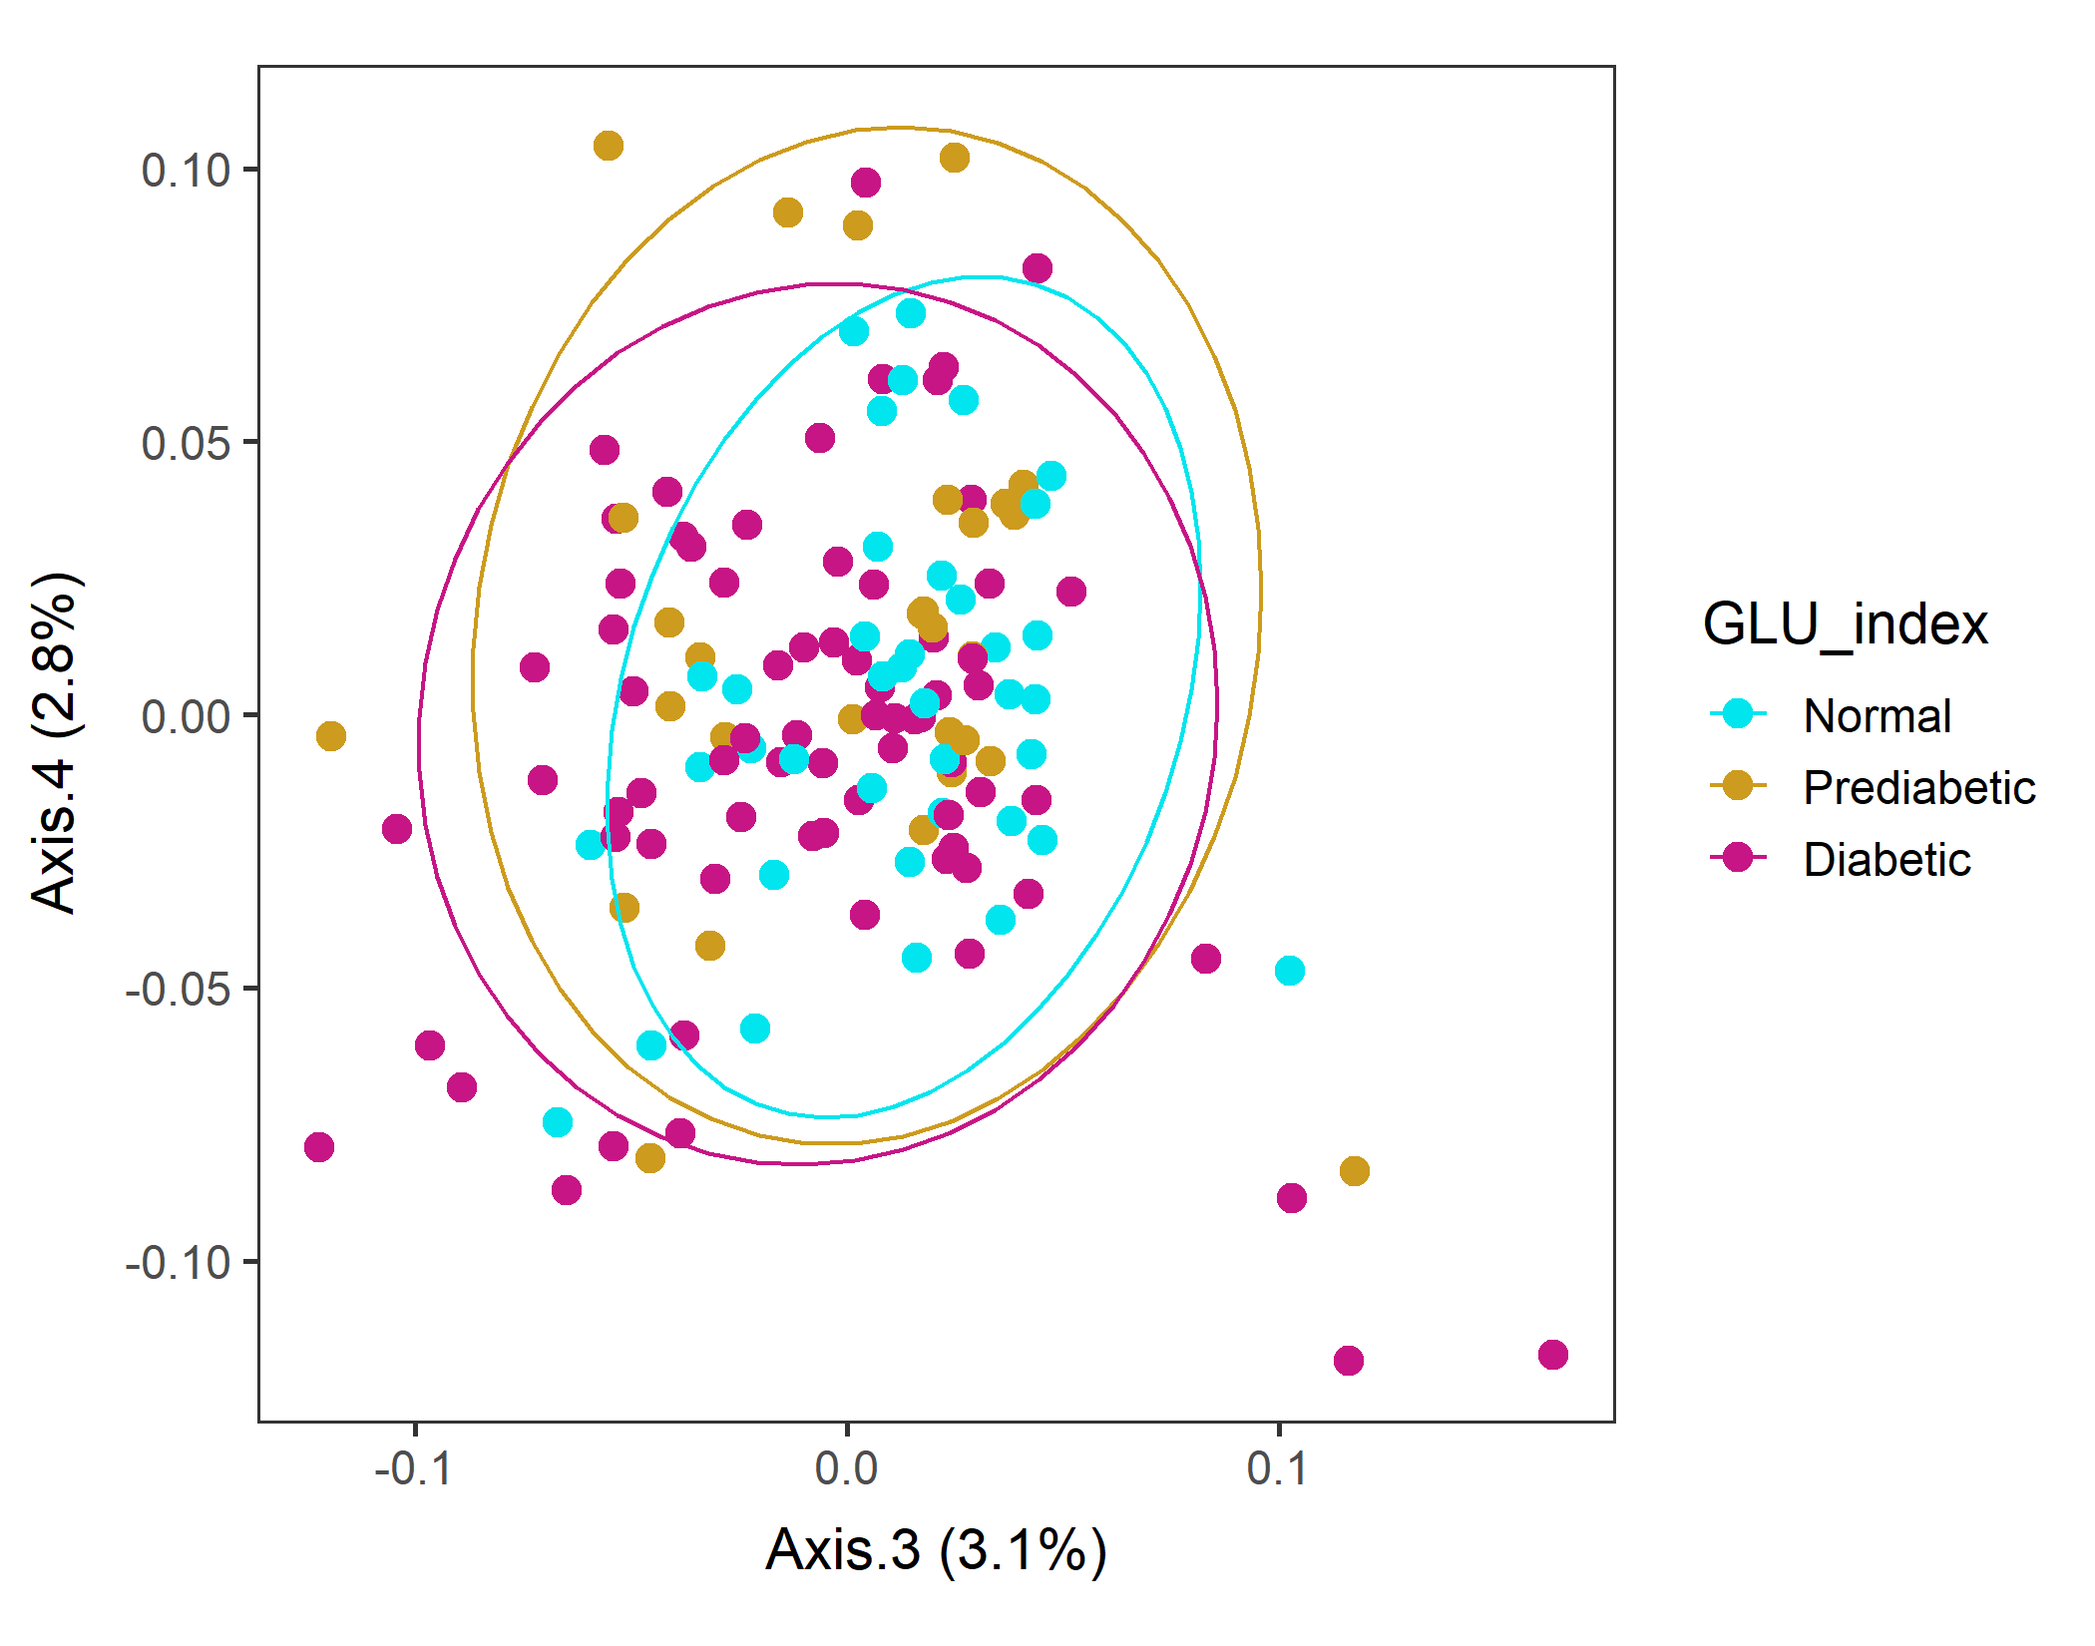
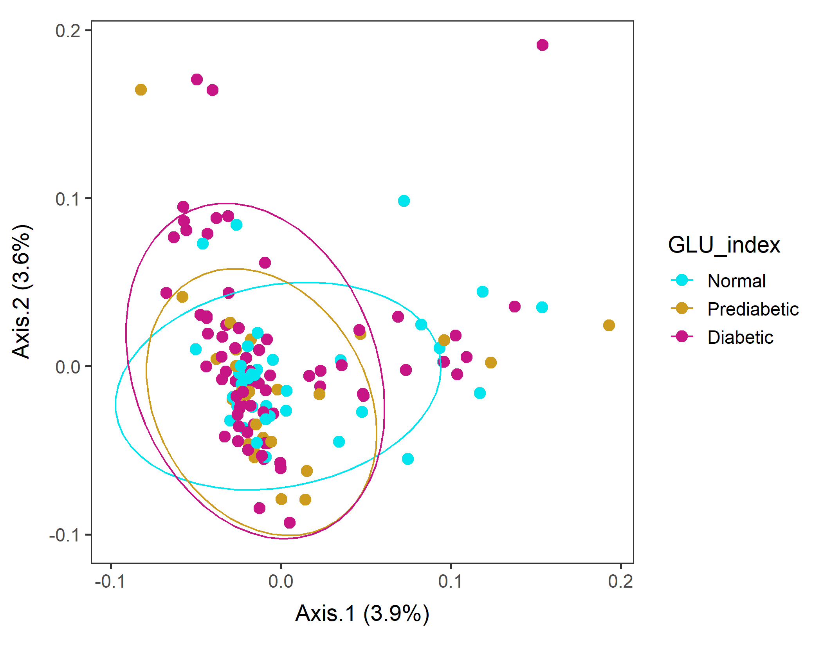
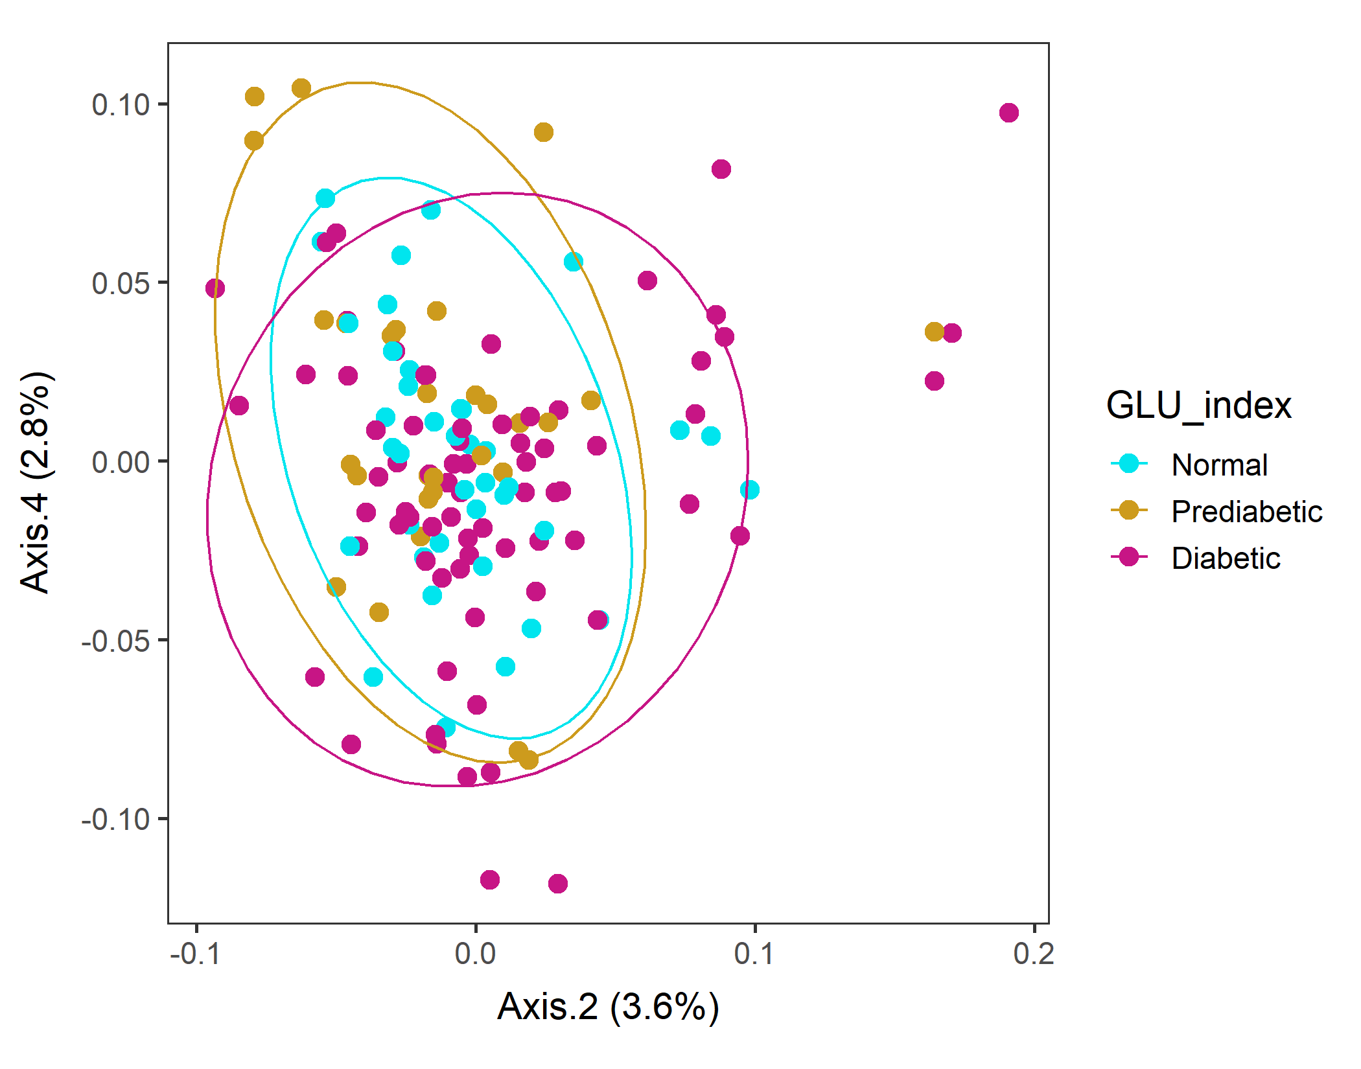
Male in 60s Lv2 WEIGHTED
Order of levels of GLU_index is incorrect!!
Axes 1&2 biplot separated Normal group
Axes 2&4 biplot separated Diabetic group
vegan::permutest: p-value ~0.3. Assumption OK.
vegan::adonis: p-value 0.02. Groups are different.

Slide 21
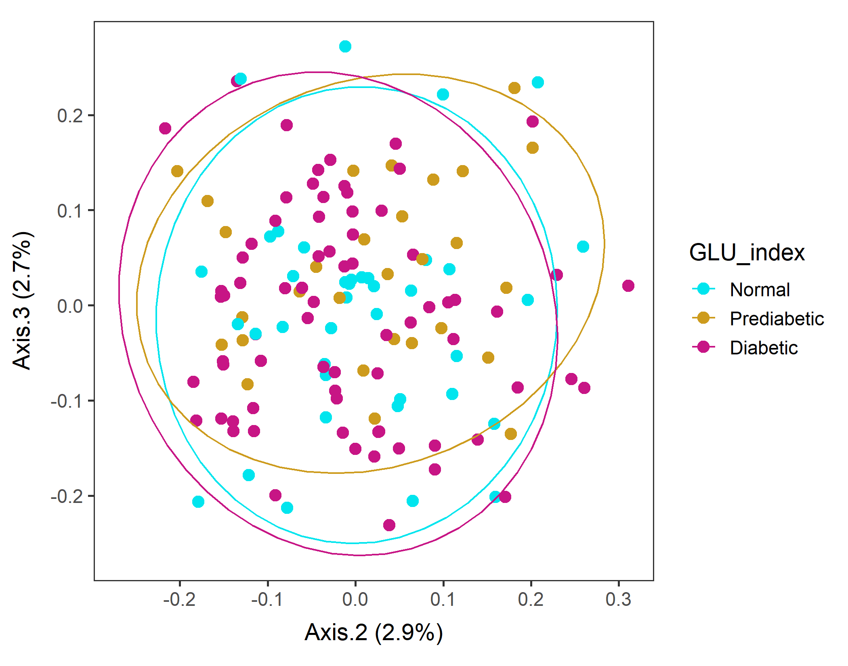
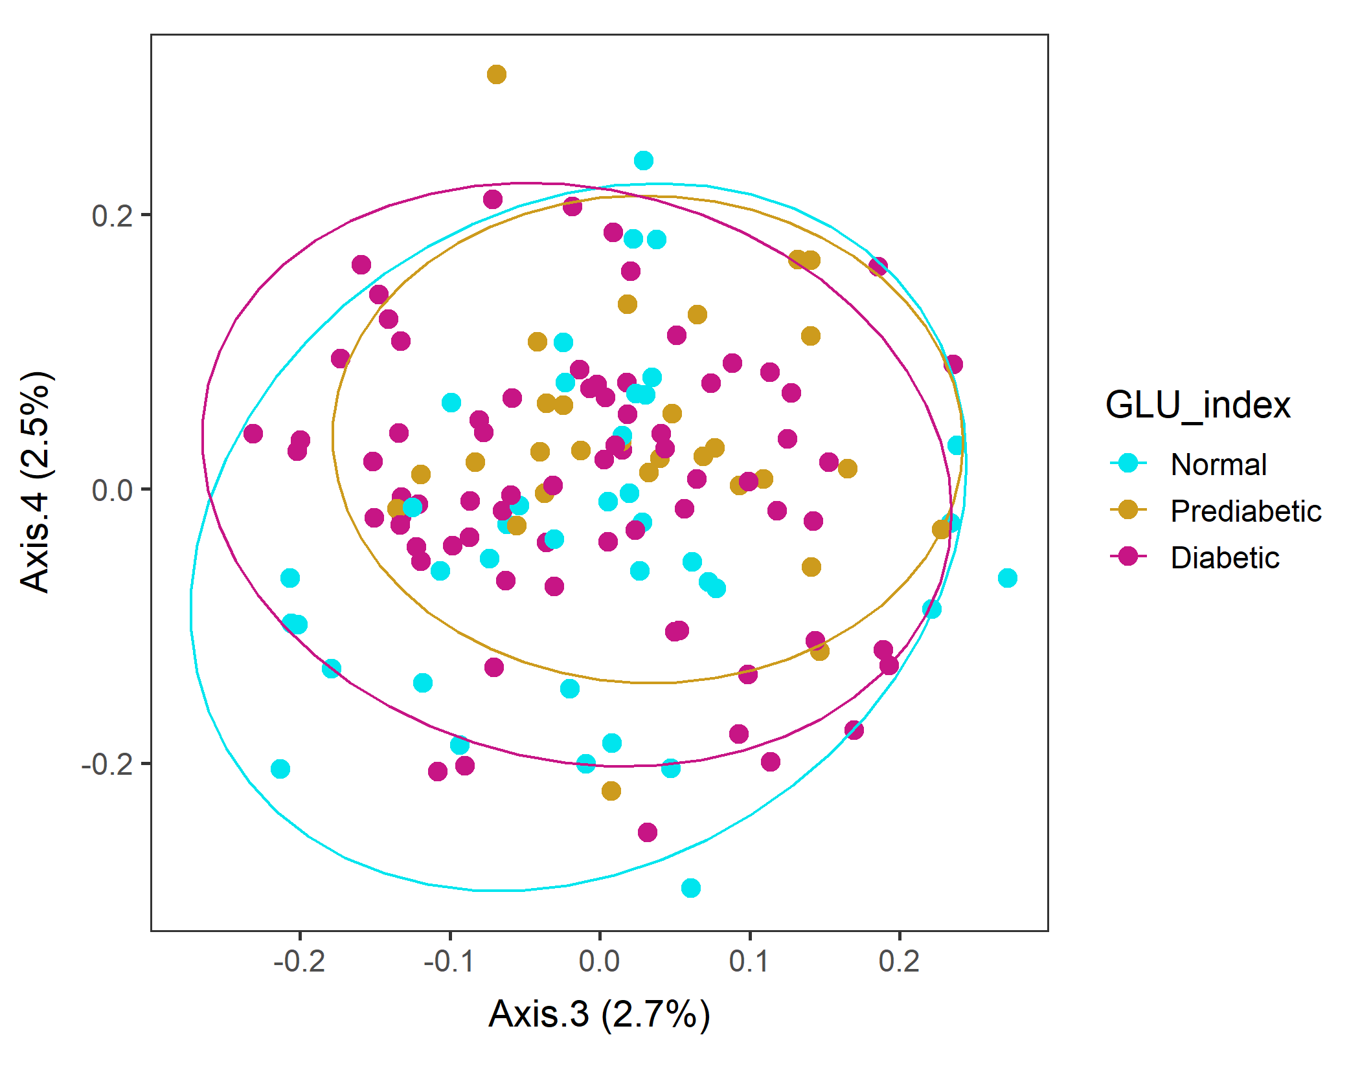
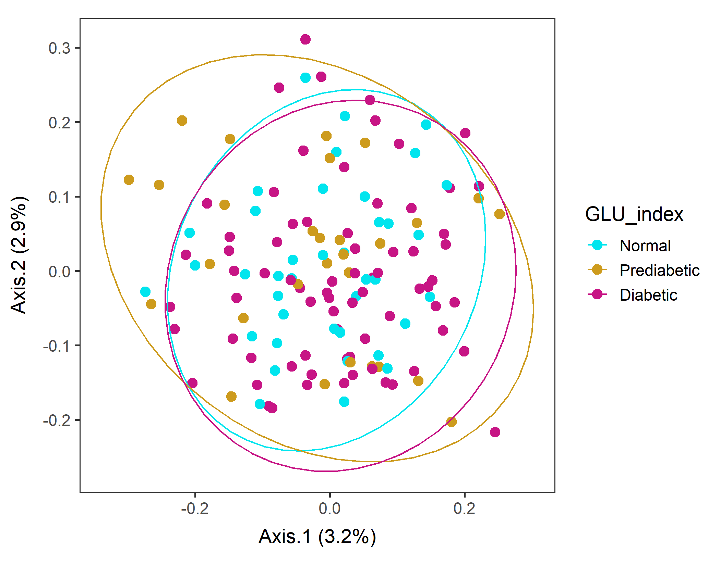
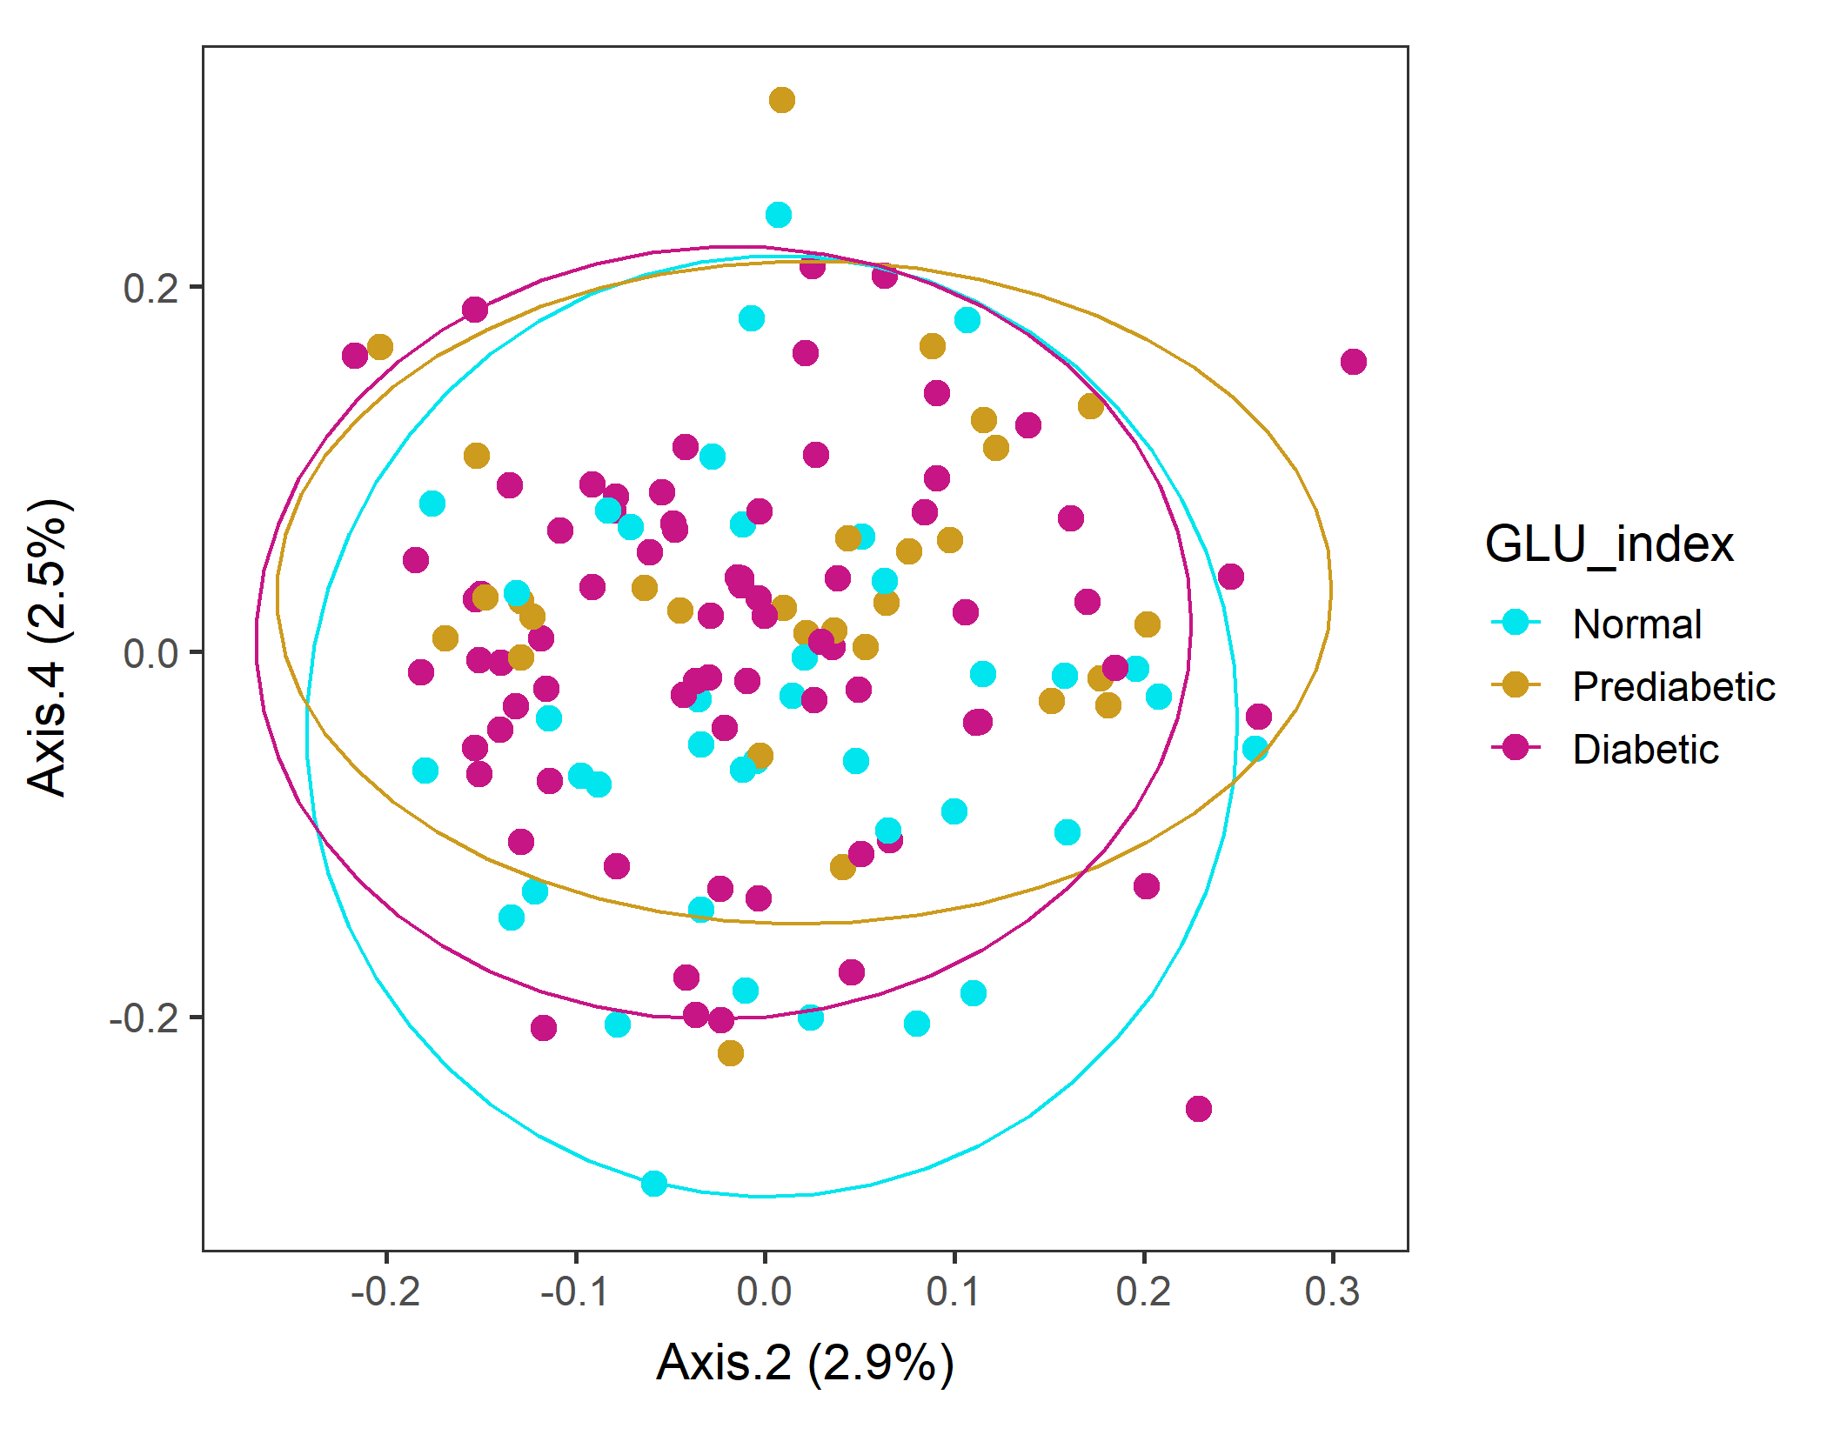
Male in 60s Lv2 UNweighted
Order of levels of GLU_index is incorrect!!
vegan::permutest: p-value ~0.7. Assumption OK.
vegan::adonis: p-value 0.02. Groups are different!

Slide 22
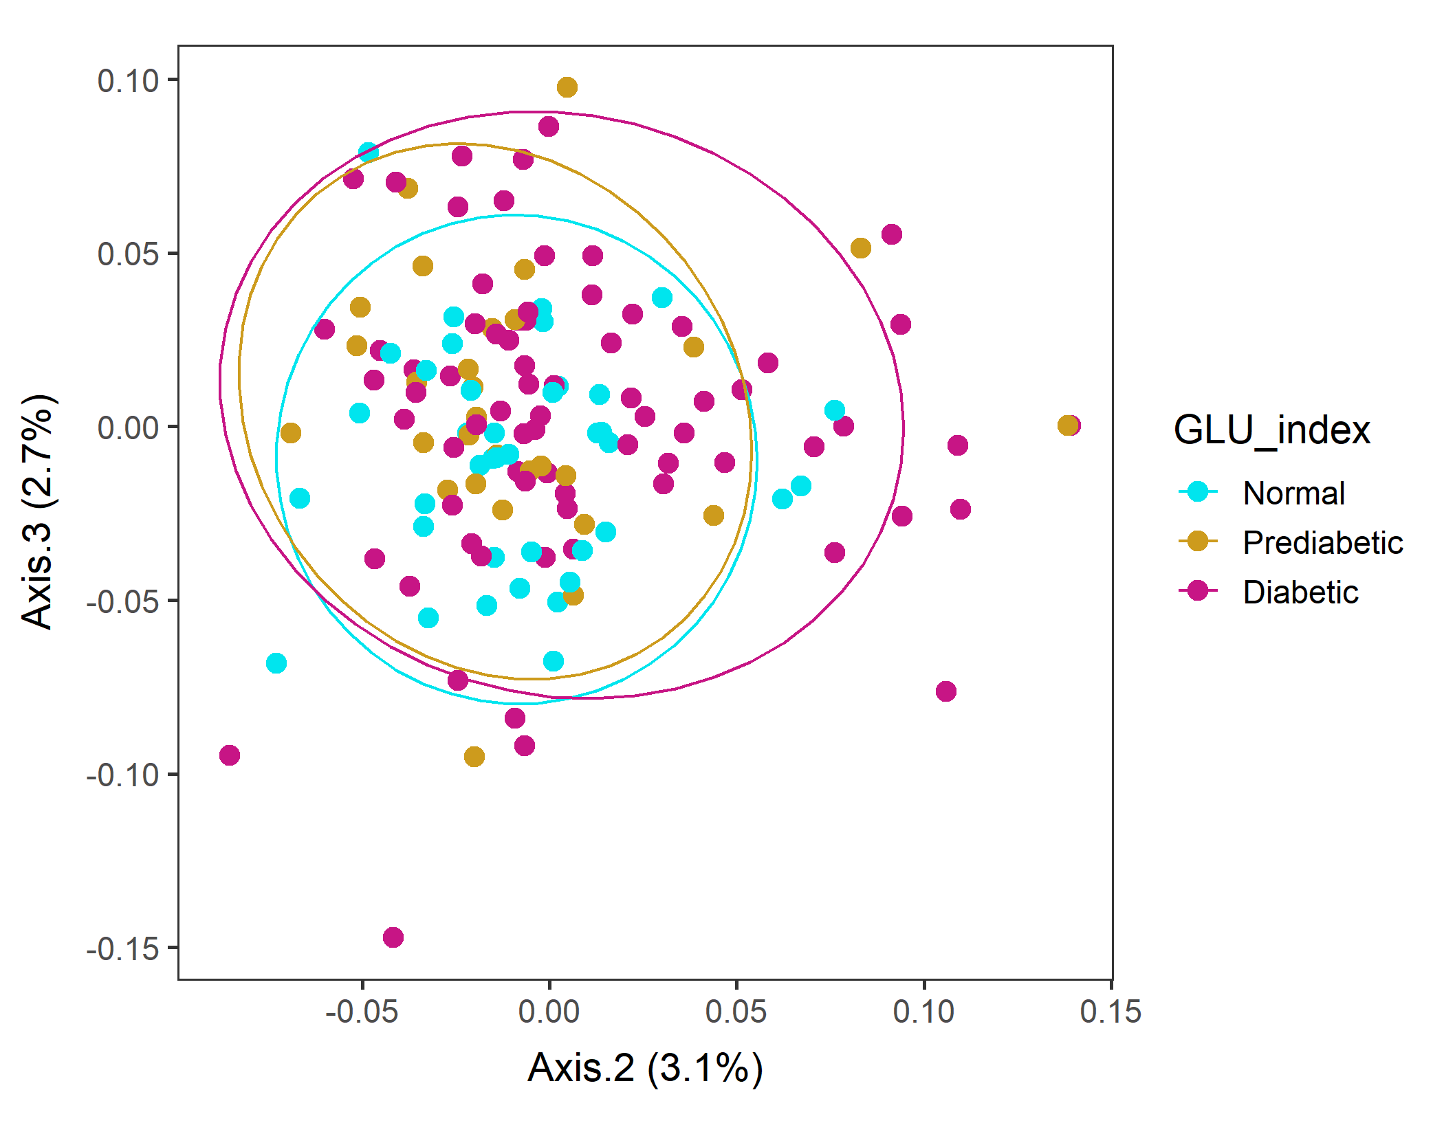
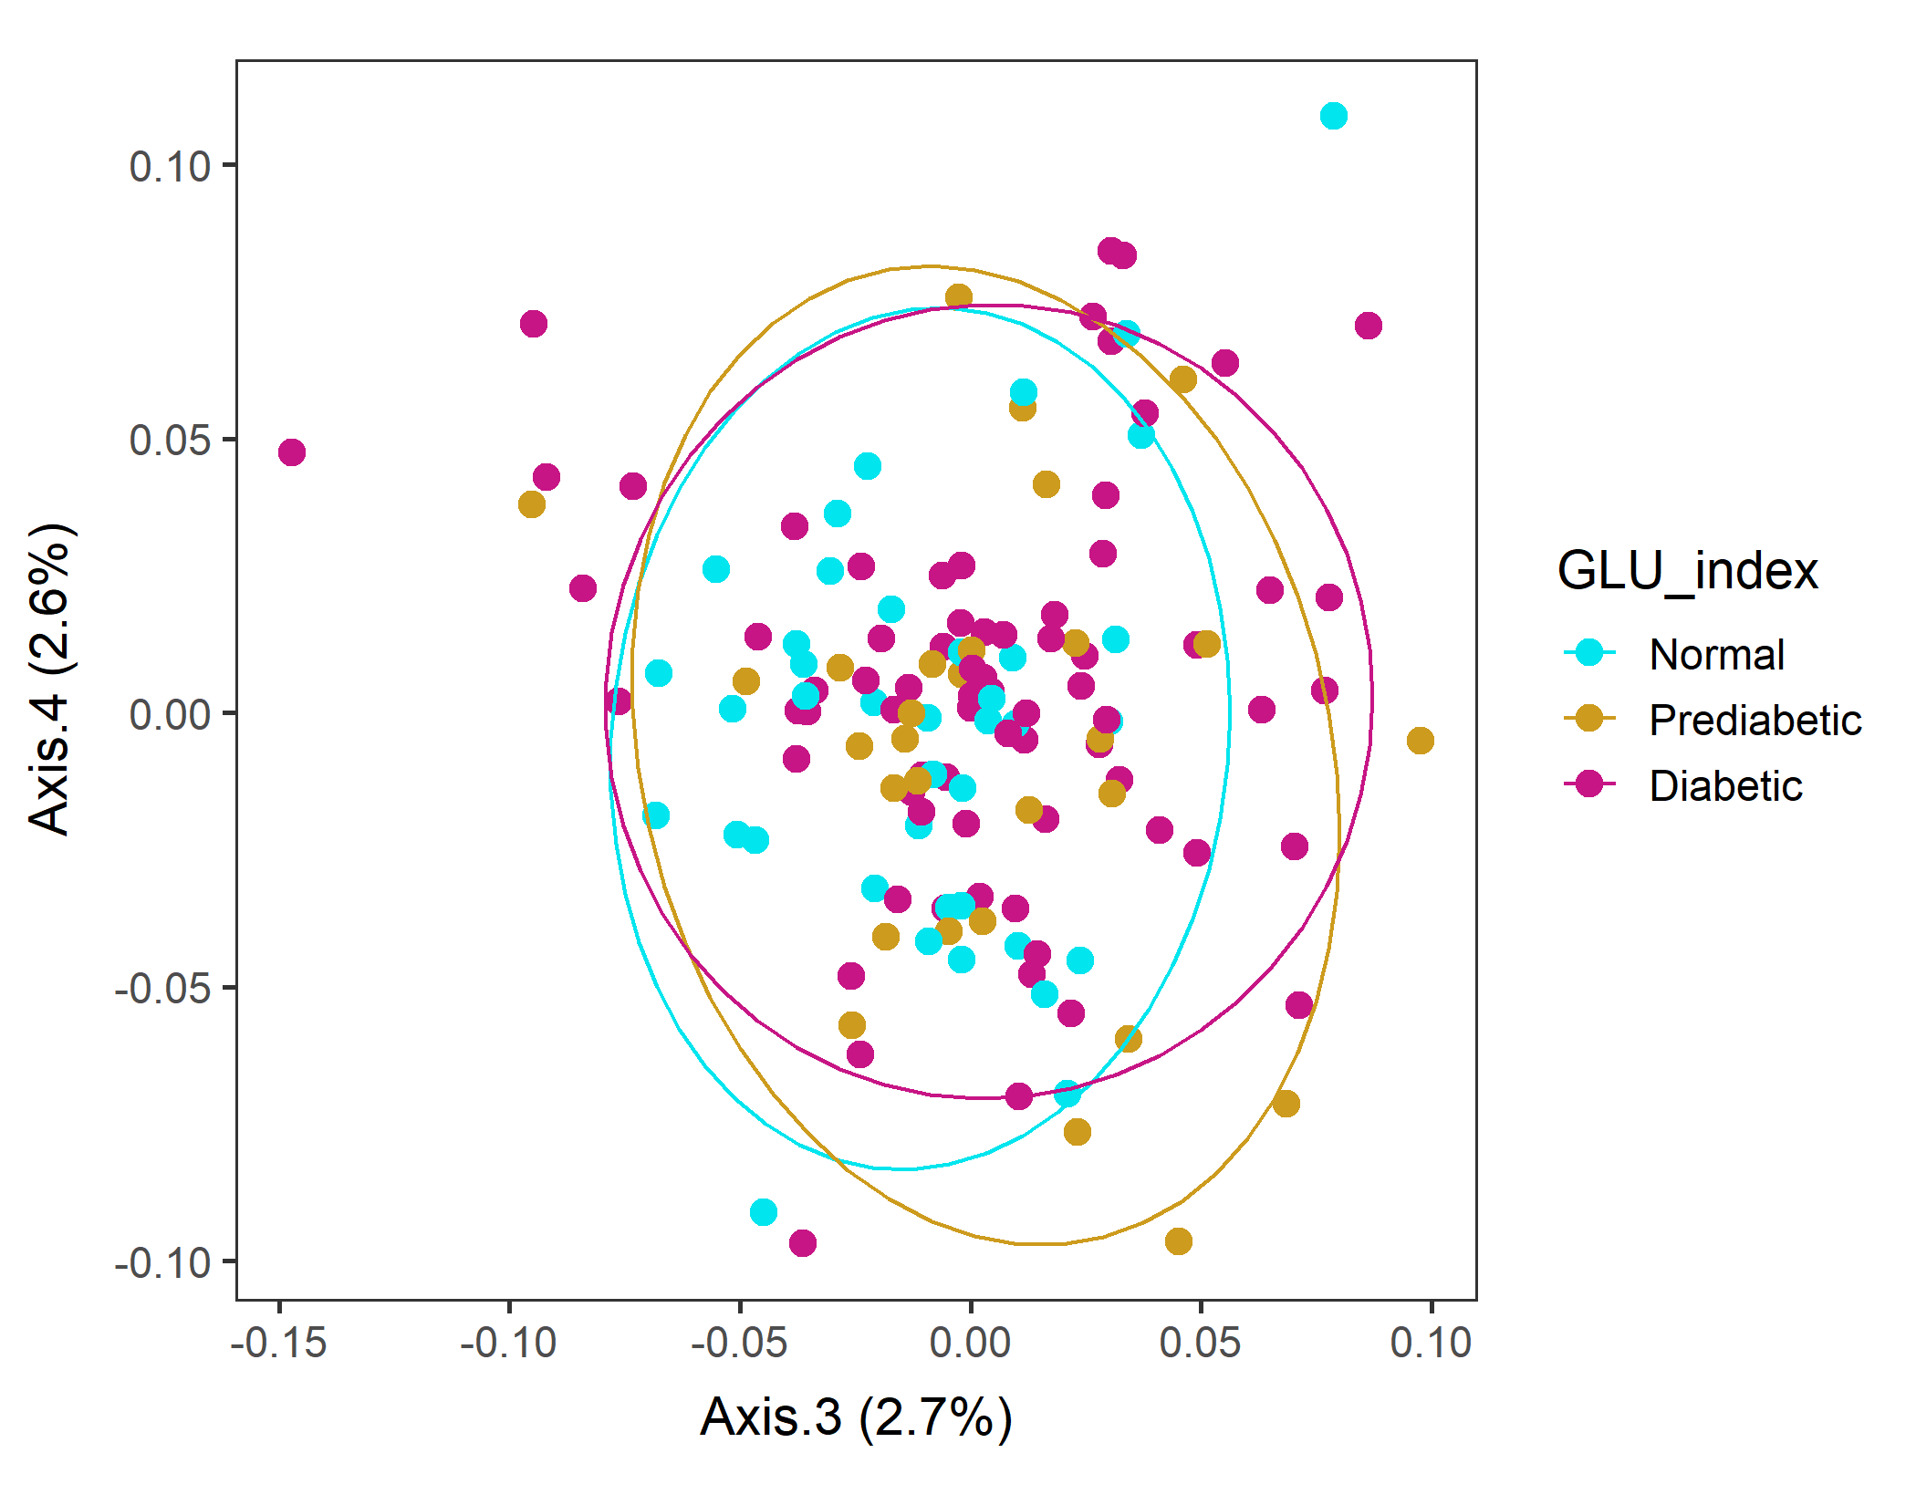
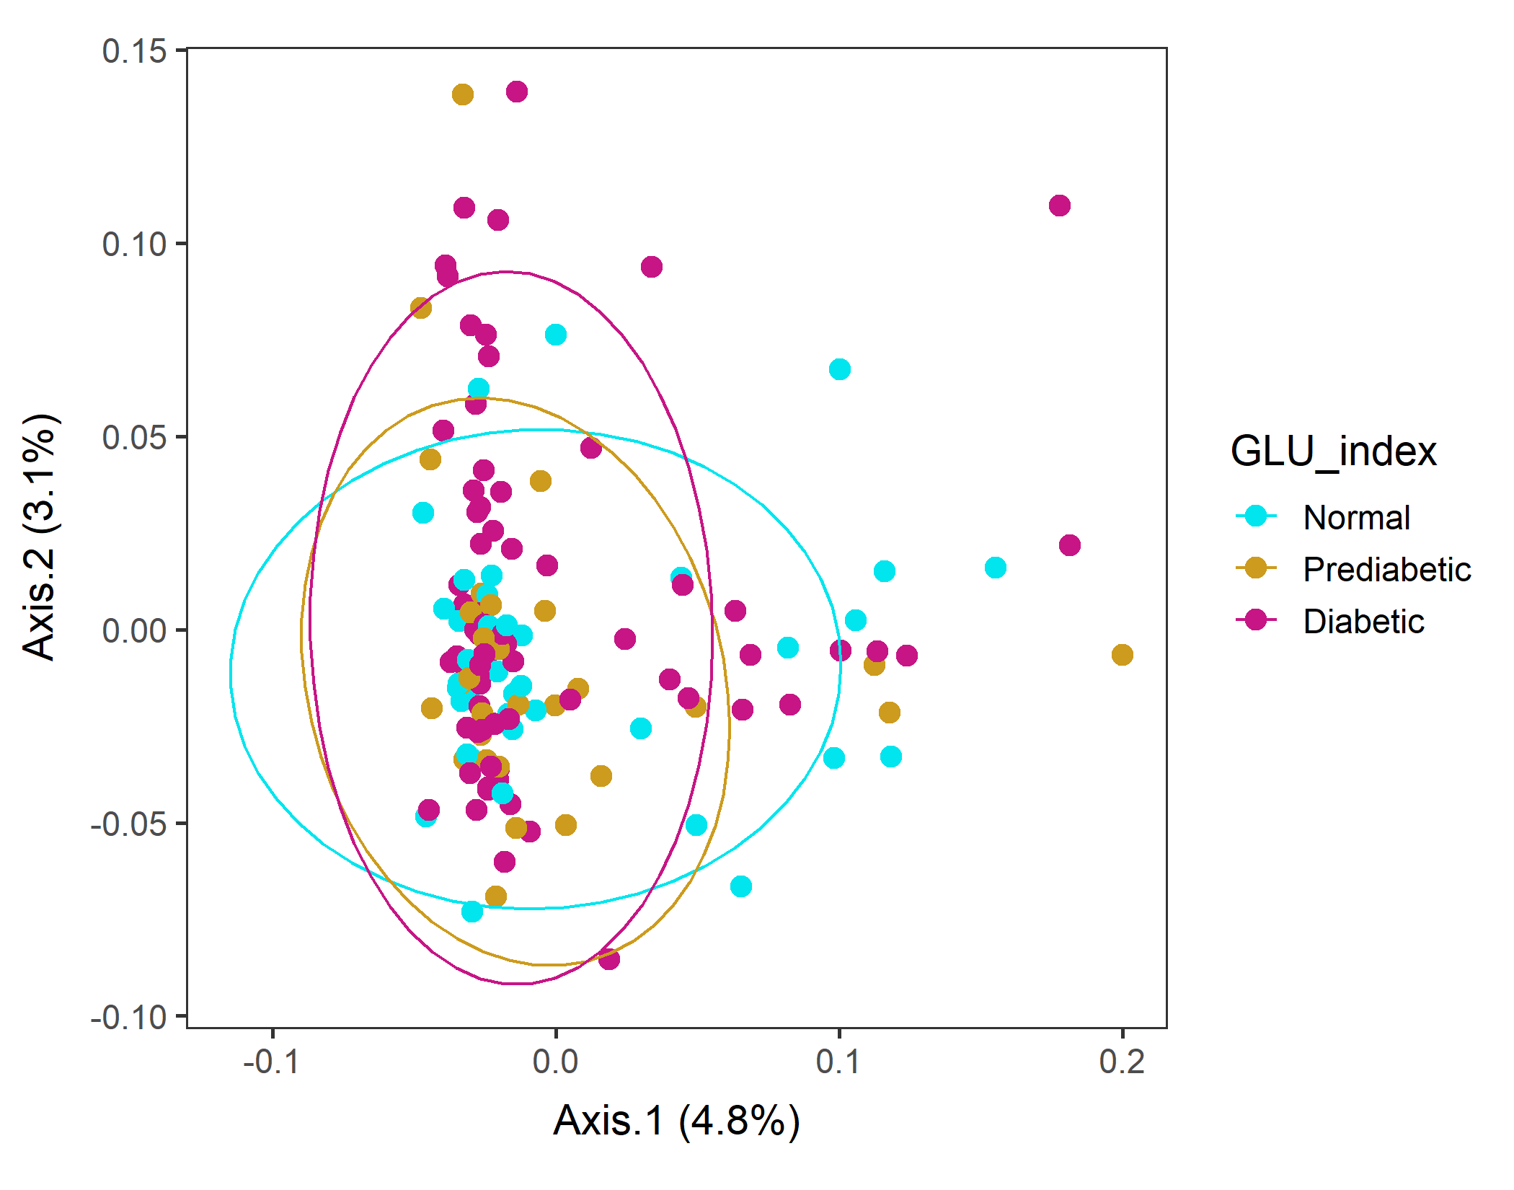
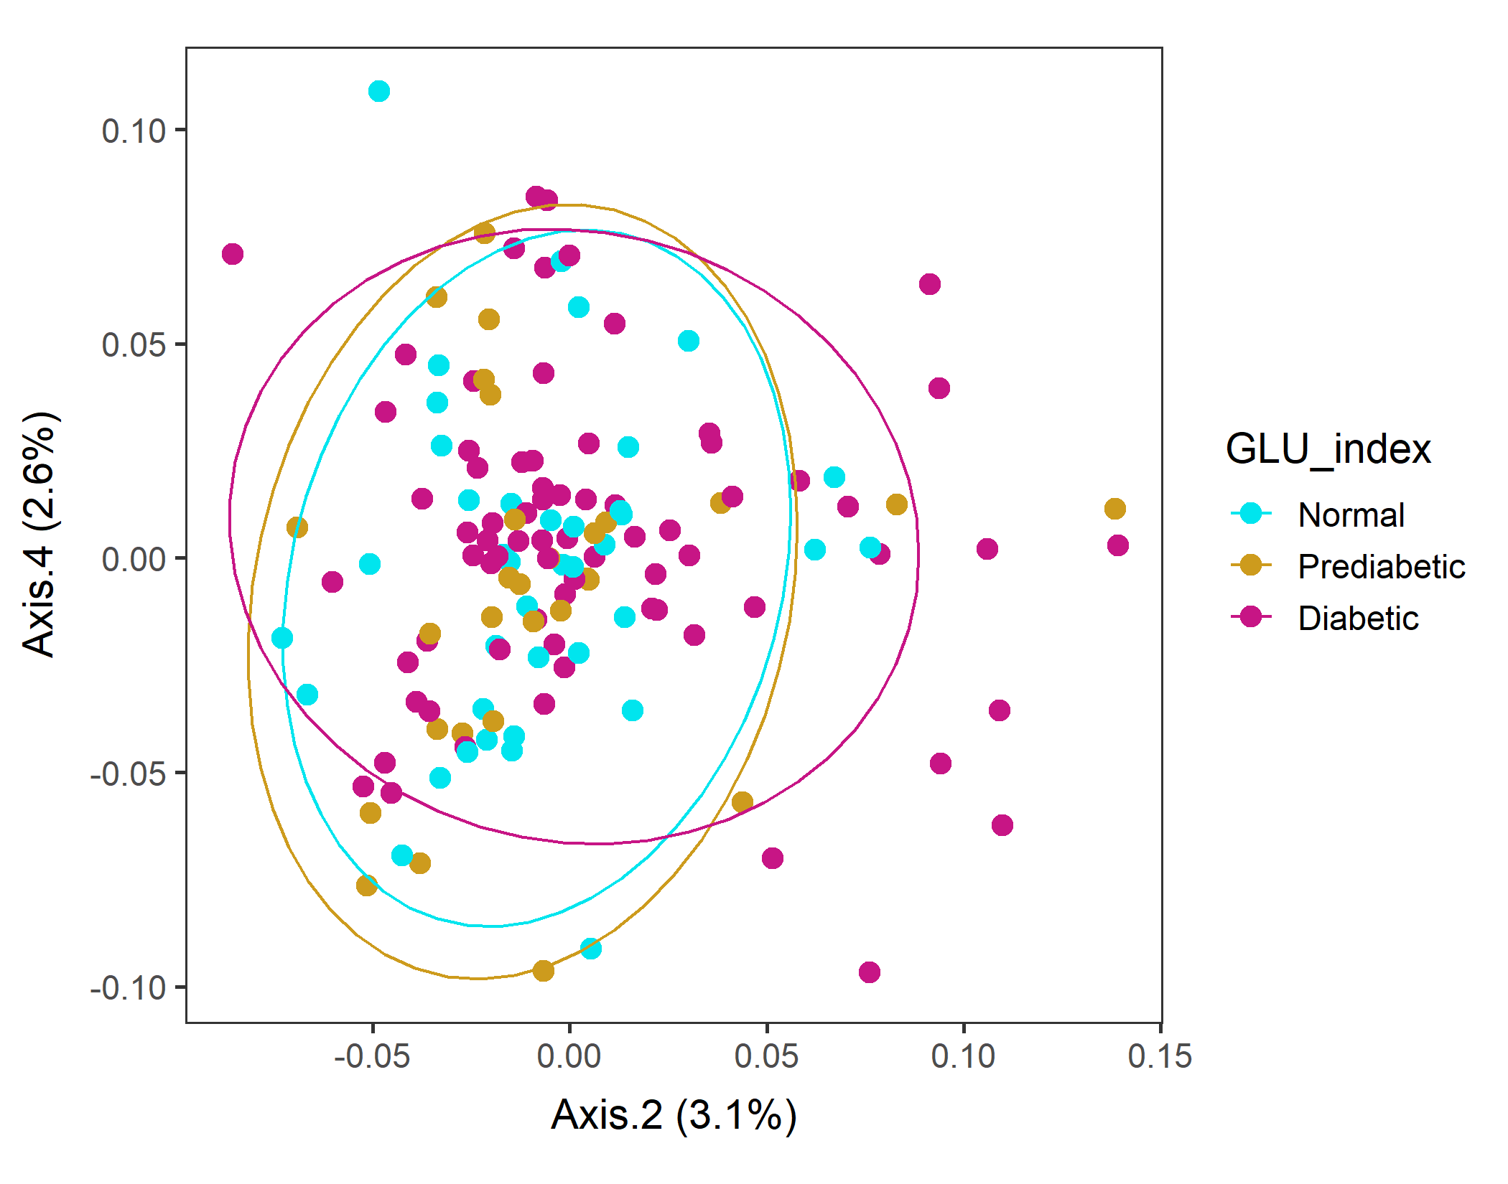
Male in 60s Lv3 WEIGHTED
Order of levels of GLU_index is incorrect!!
vegan::permutest: p-value ~0.49. Assumption OK.
vegan::adonis: p-value 0.054. Groups are borderline different.

Slide 23
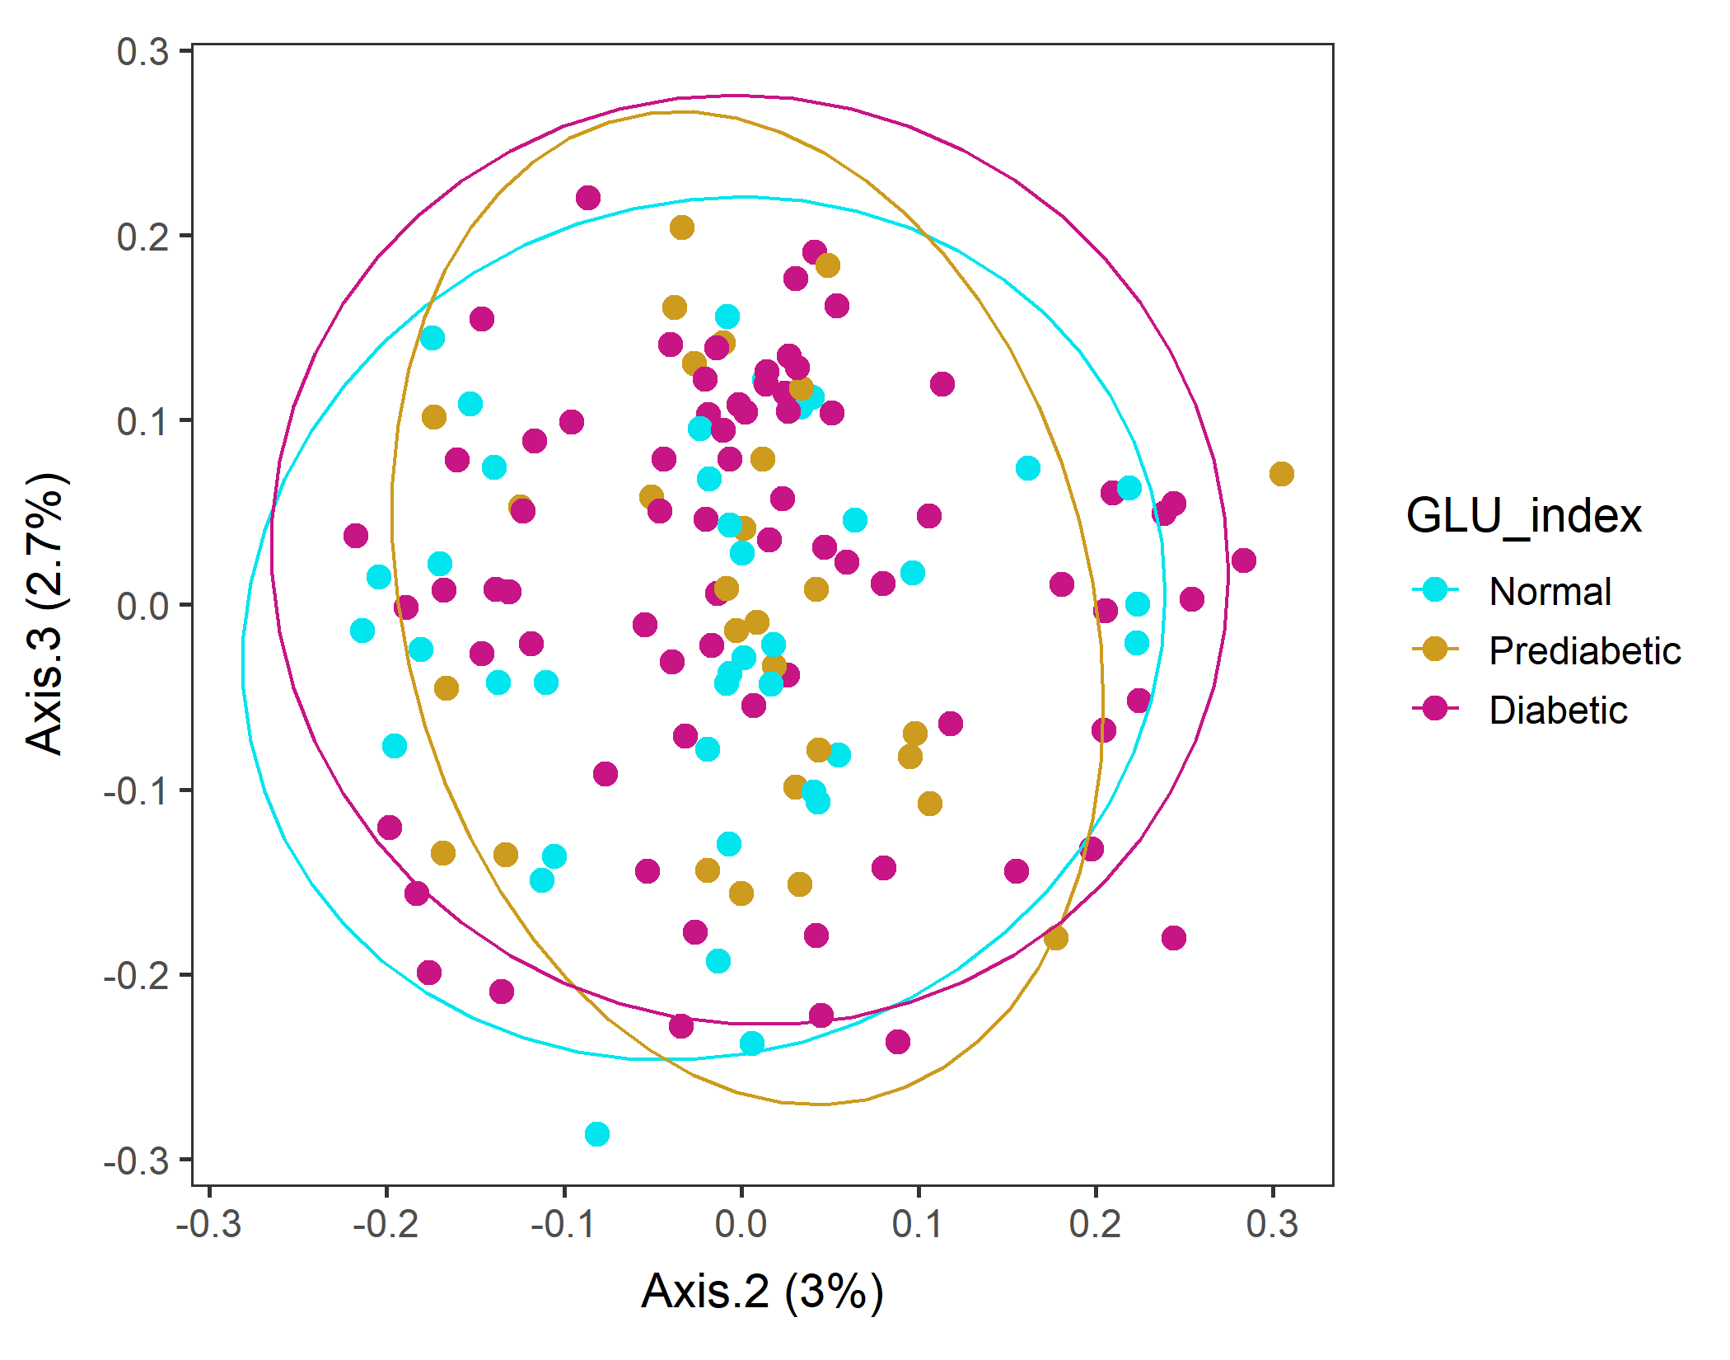
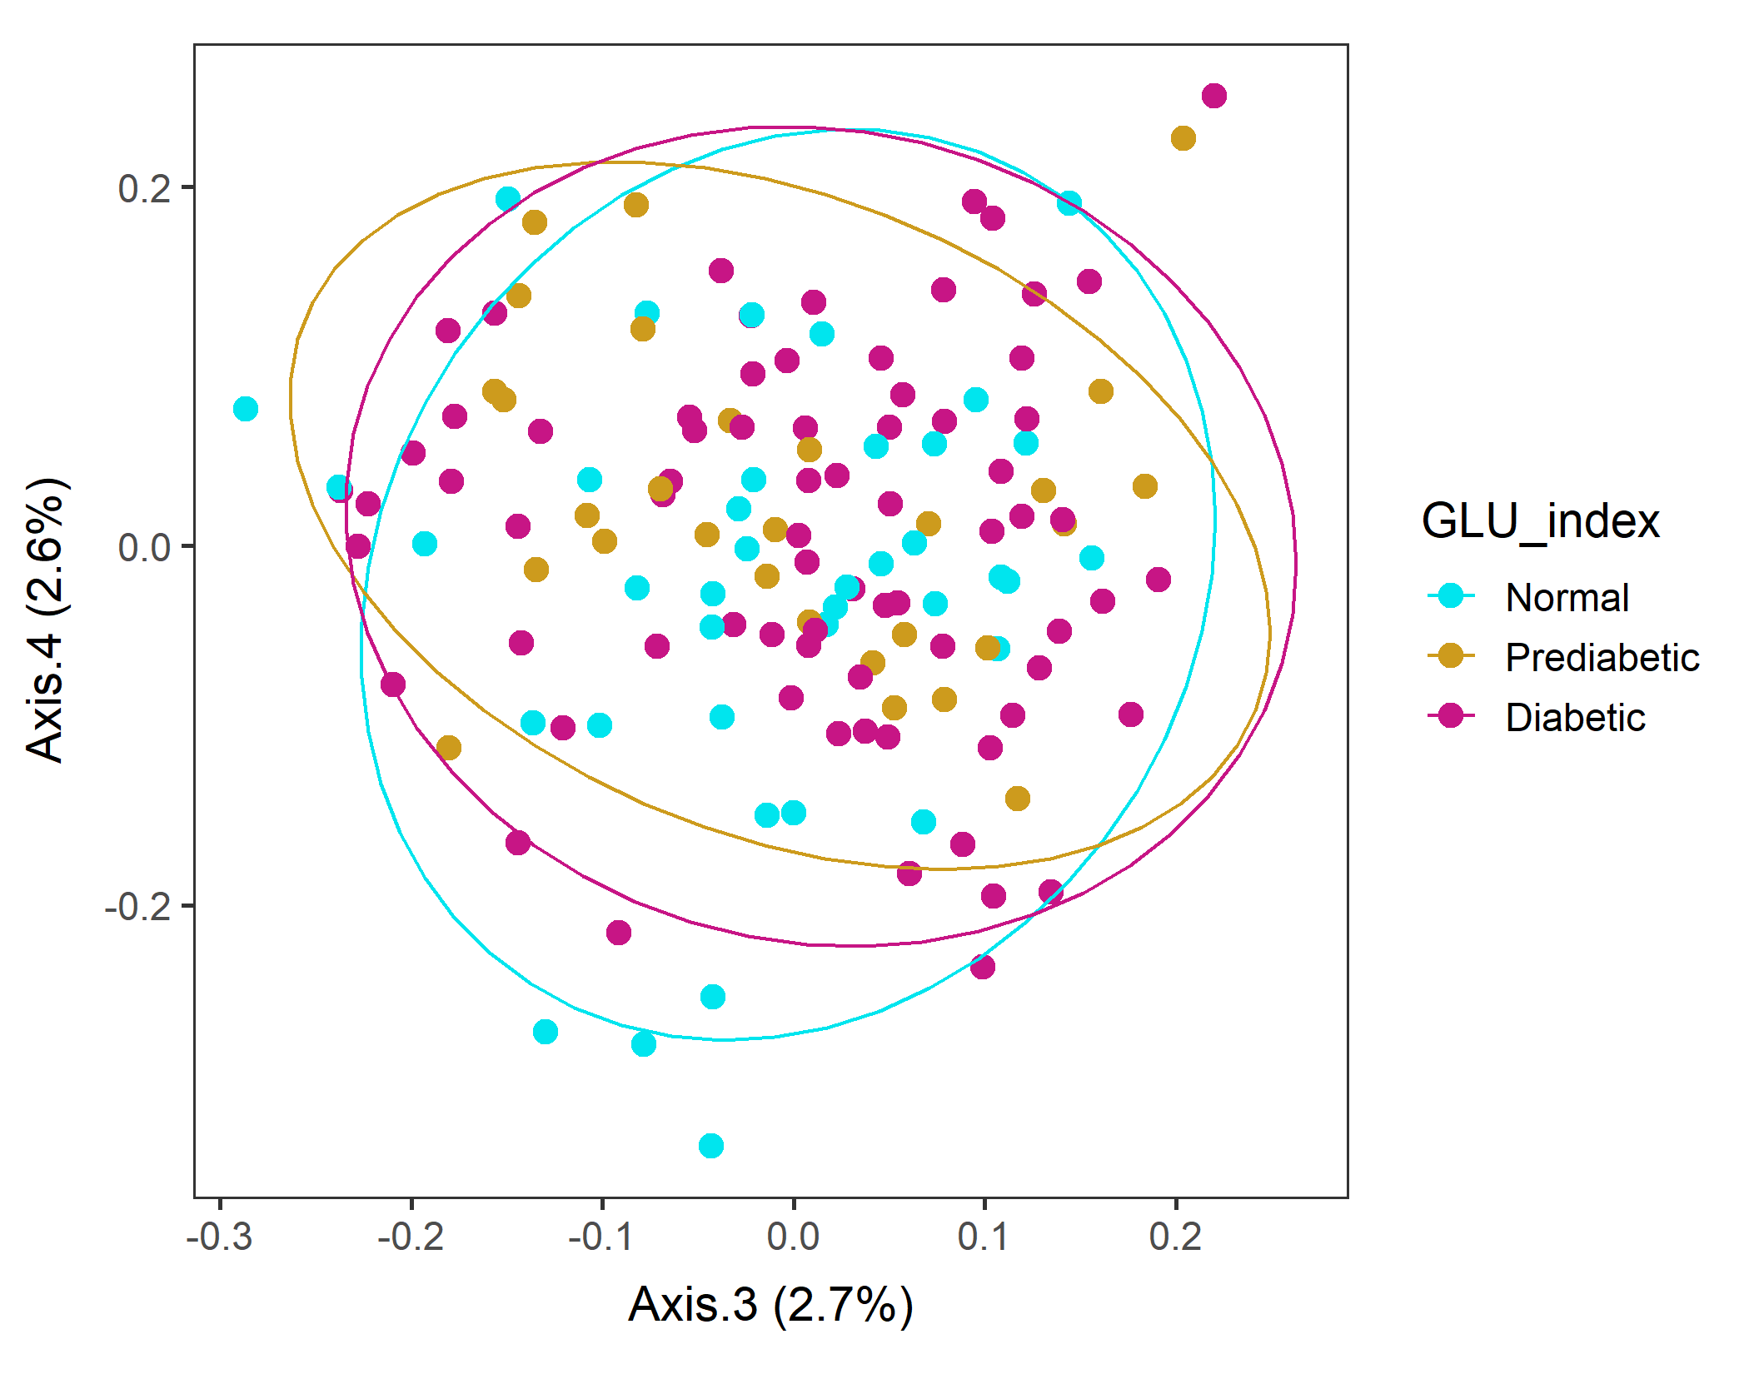
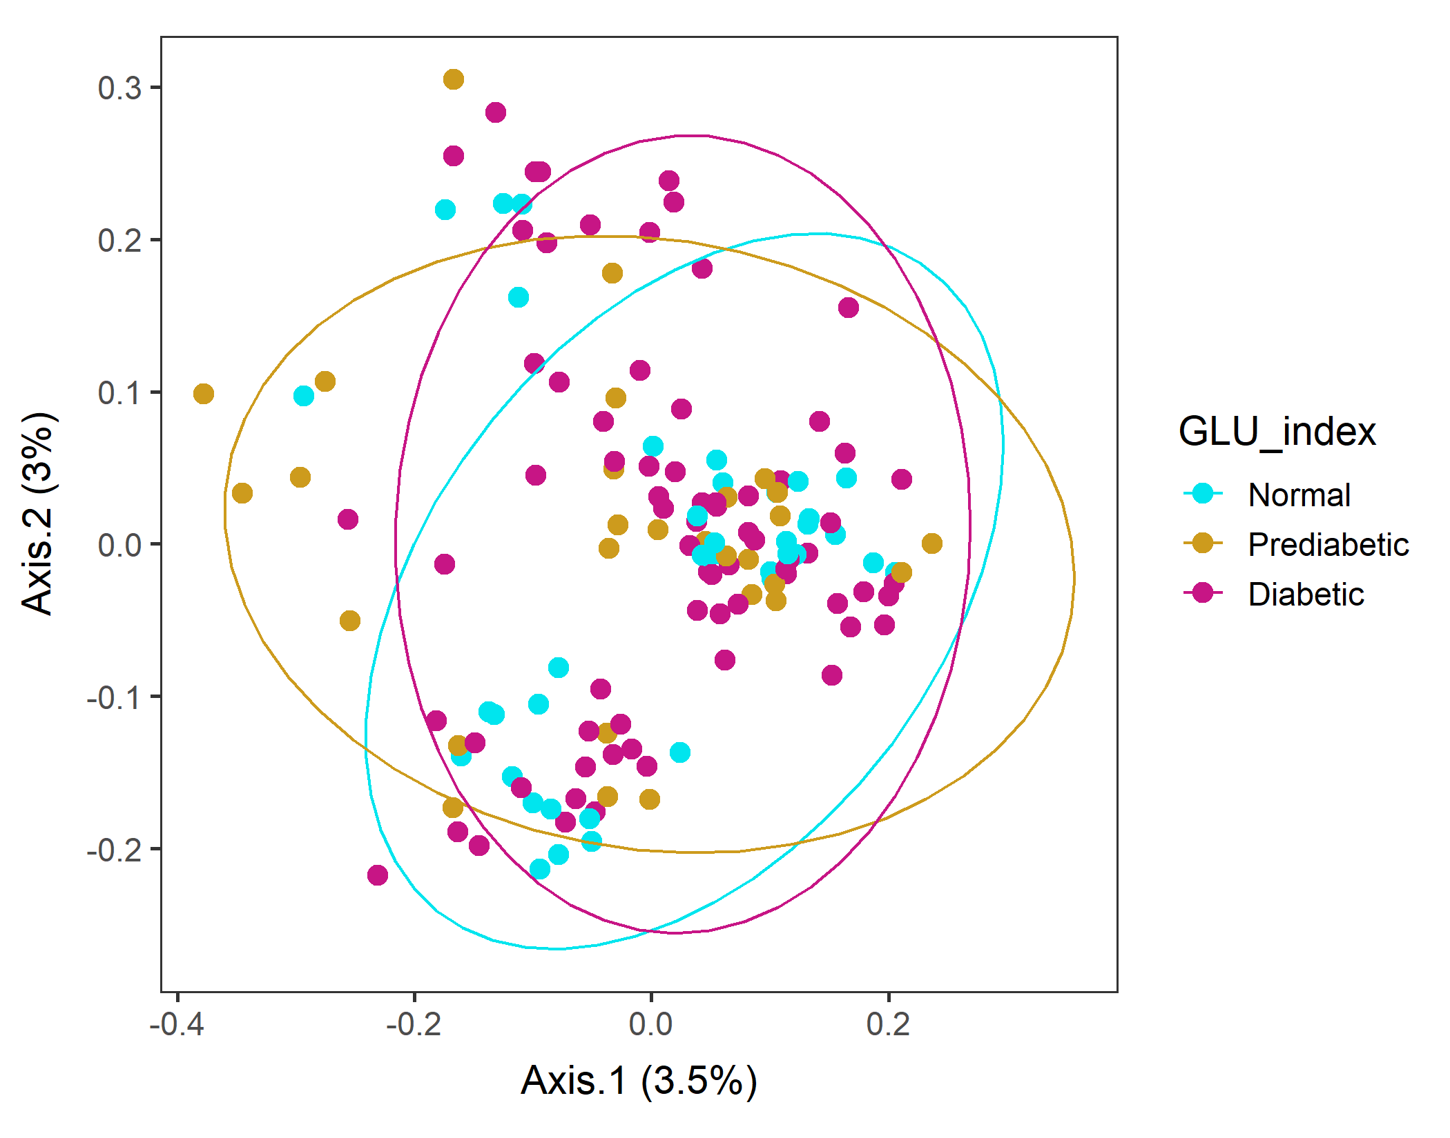
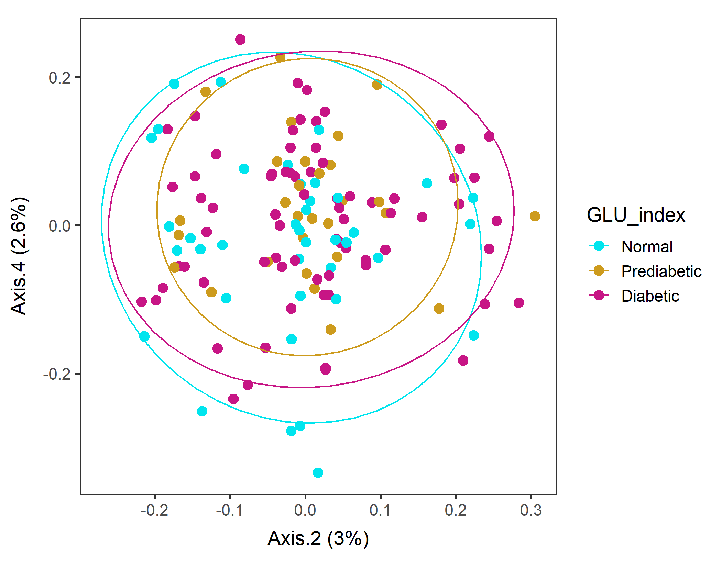
Male in 60s Lv3 UNweighted
Order of levels of GLU_index is incorrect!!
vegan::permutest: p-value ~0.57. Assumption OK.
vegan::adonis: p-value 0.03. Groups are different!

Slide 24
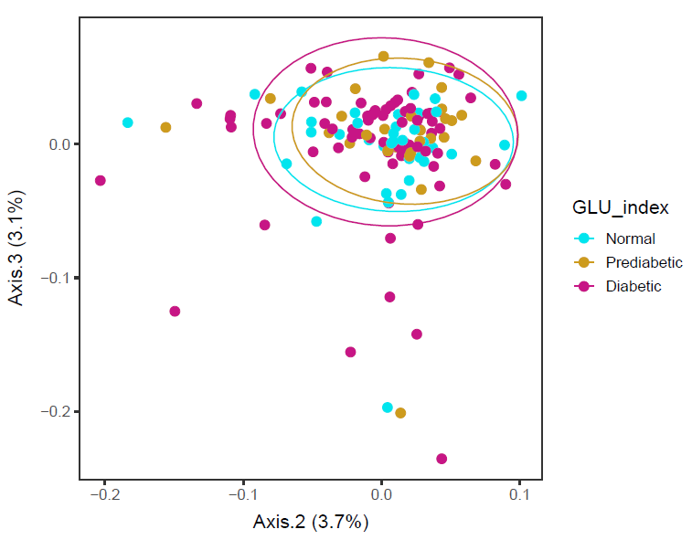
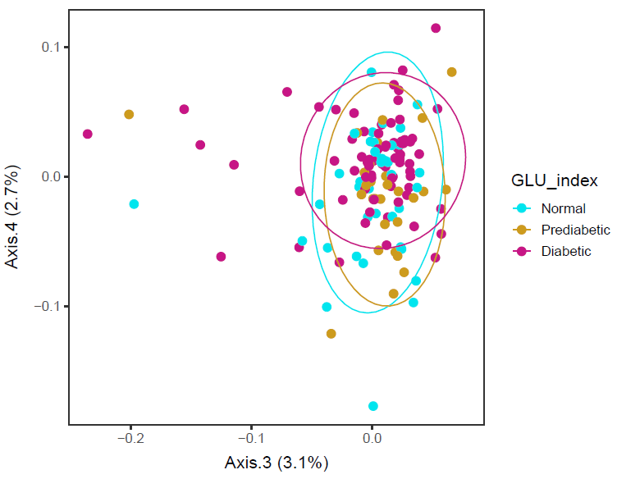
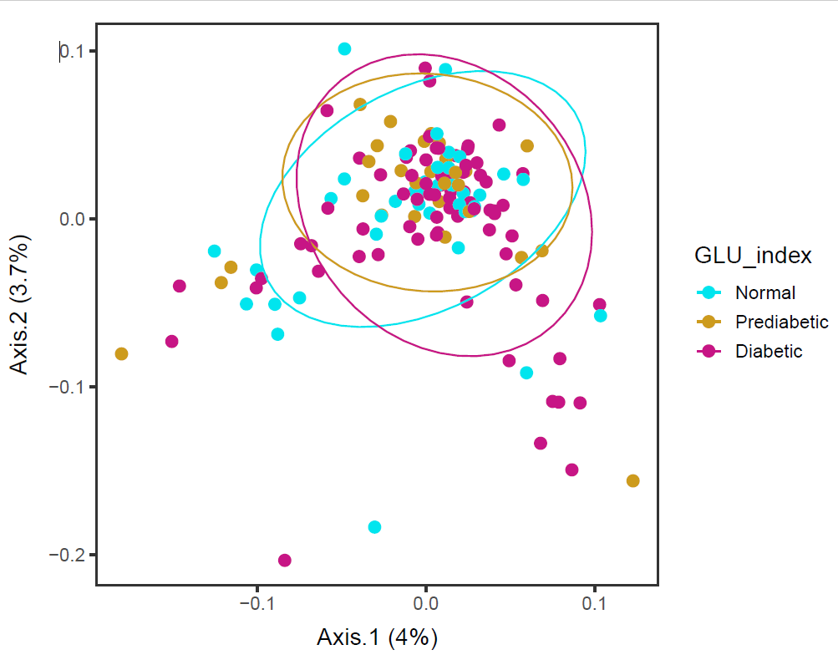
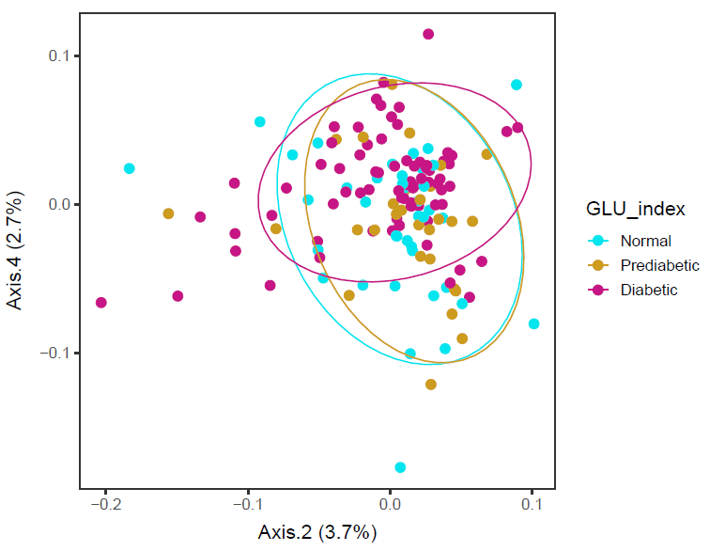
Male in 60s Lv4 WEIGHTED
Order of levels of GLU_index is incorrect!!
Axes 3&4 biplot and Axes 2&4 biplot separated Diabetic group
vegan::permutest: p-value ~0.18. Assumption OK.
vegan::adonis: p-value 0.05. Groups are borderline different.
Maybe 3D will work…?

Slide 25
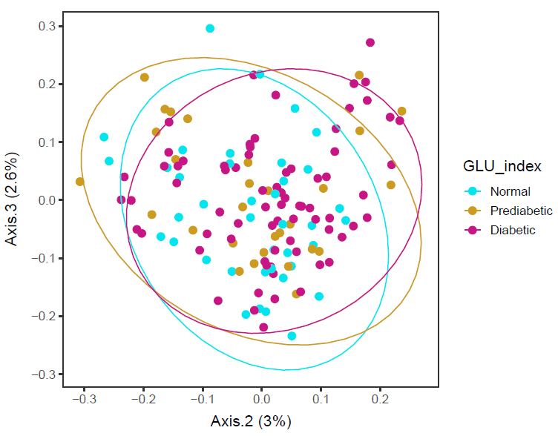
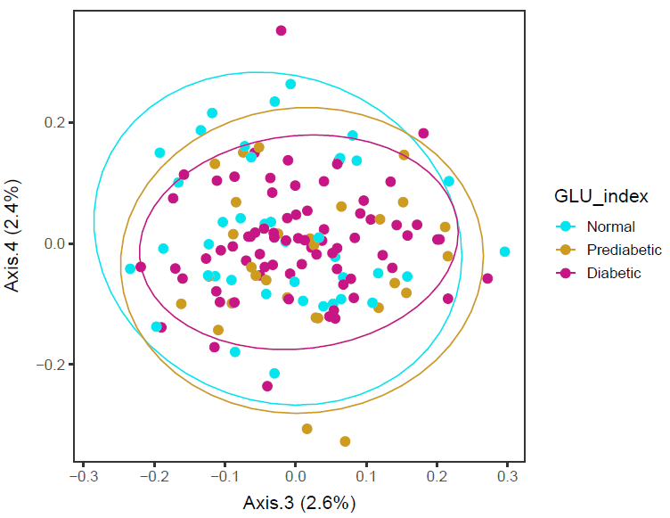
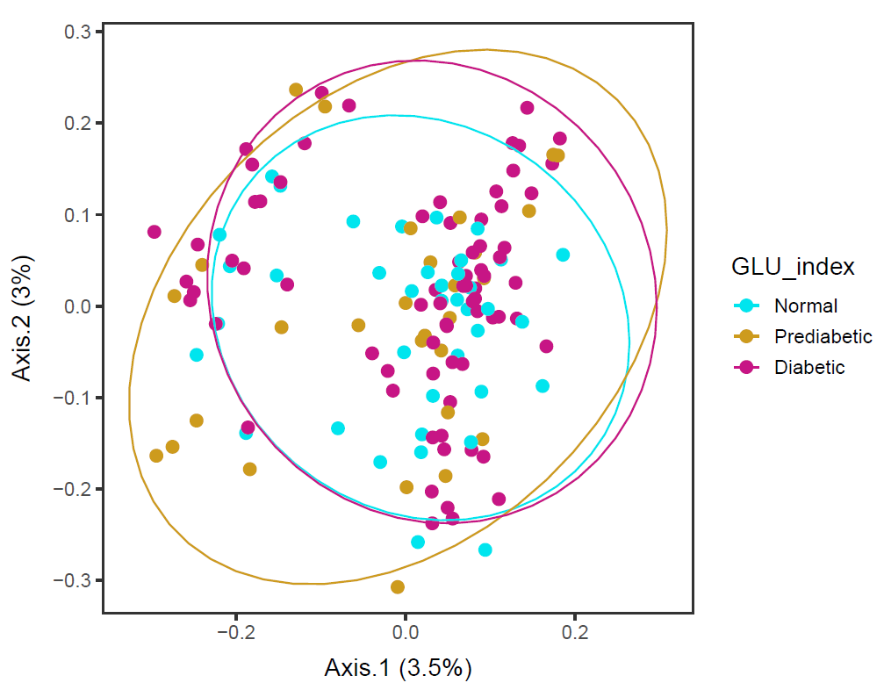
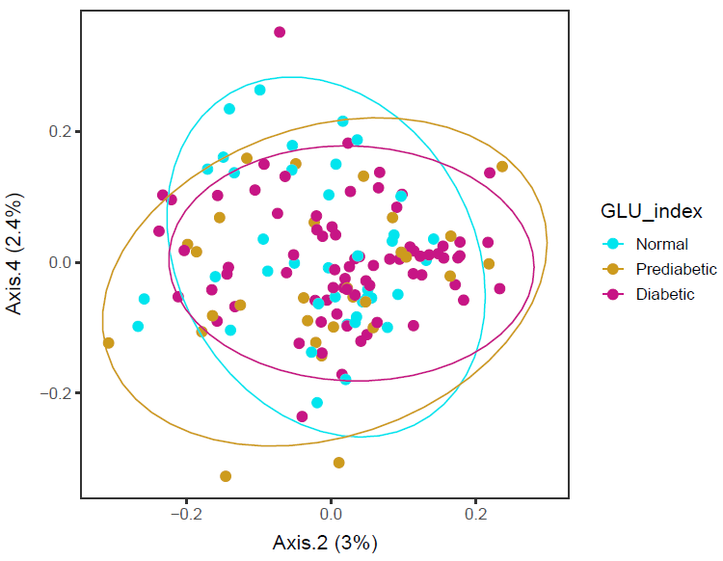
Male in 60s Lv4 UNweighted
Order of levels of GLU_index is incorrect!!
Axes 2&4 biplot separated Normal group
For both weighted and unweighted, Axes 2&4 separated groups.
Unweighted is presence or absence.
vegan::permutest: p-value ~0.27. Assumption OK.
vegan::adonis: p-value 0.05. Groups are borderline different. But in this, Prediabetic looks different from the others.

Slide 26
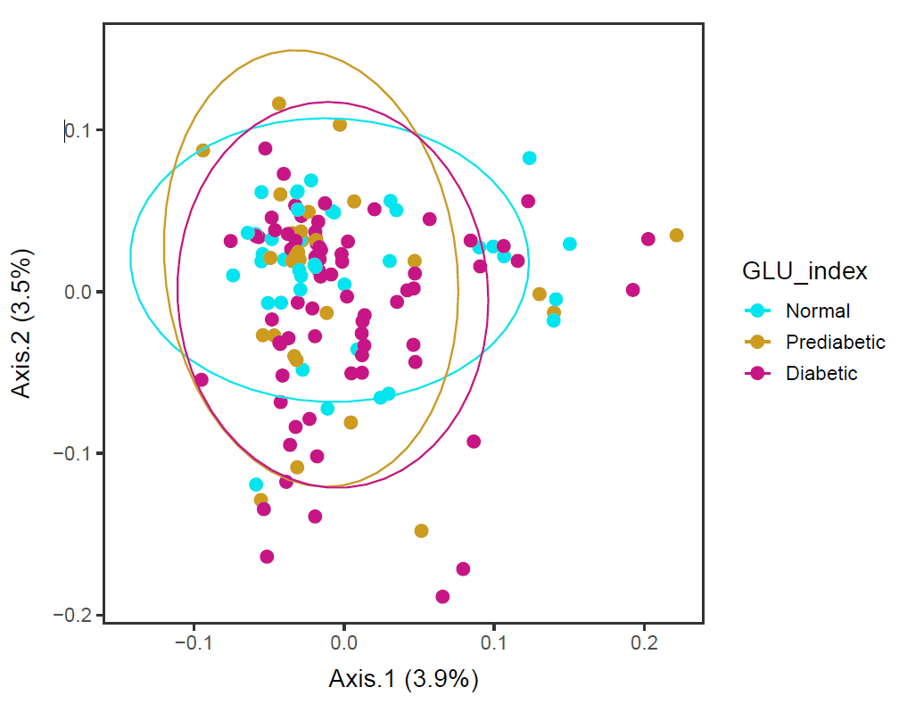
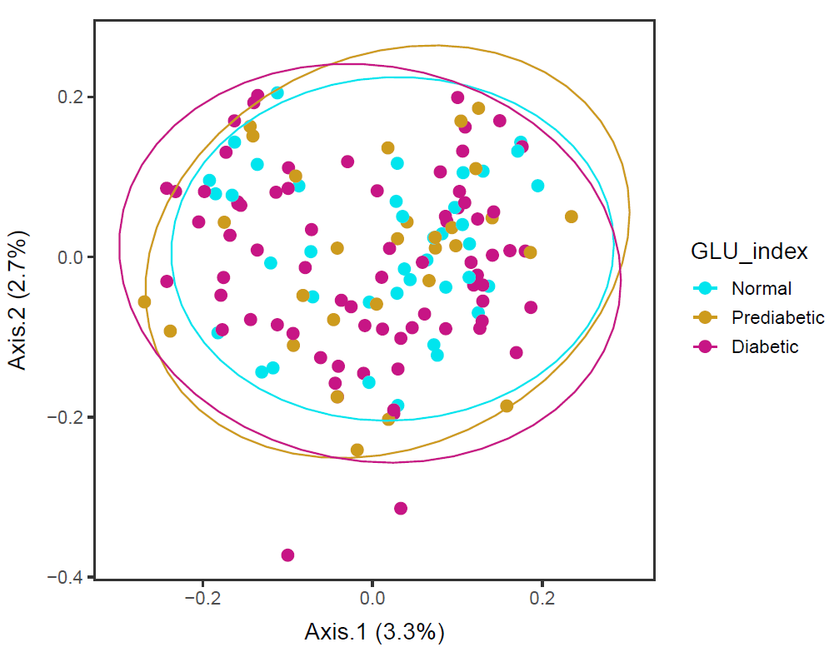
Male in 60s Lv5
Order of levels of GLU_index is incorrect!!
Lv5_ord_WEIGHTED, no error in ordination
Lv5_ord_UNweighted
vegan::permutest: p-value ~0.10. Assumption OK.
vegan::adonis: p-value 0.08. Groups are almost borderline different.
vegan::permutest: p-value ~0.50. Assumption OK.
vegan::adonis: p-value 0.05. Groups are borderline different.

Slide 27
Males in 60s Lv4 and Lv5
Ordination results are influenced by
- food tree level and
- whether weighted or unweighted unifrac distance
is used.
But at level 4 and level 5, the three GLU index groups are almost different, while their dispersions are not different.

Slide 28
Males in 60s Lv6
ordinated_w <- phyloseq::ordinate(phyfoods, method="PCoA", distance="unifrac", weighted=TRUE)
# GIVES ERROR...
Error in h(simpleError(msg, call)) :
error in evaluating the argument 'x' in selecting a method for function 'colSums': subscript out of bounds
Lv6 food tree can be visualized with no problem, but ordination cannot be done…

Slide 29


Males in 60s PCA Nutrients
Prediabetic and Diabetic has points in the top right direction. That is associated with higher general food intake..? TFAT, SODI, etc.

Slide 30

Males in 60s BMI
ANOVA – significant (p-value=0.0026).
Diabetic is different from Normal and Prediabetic, but
Normal and Prediabetic are not different.
data: df$BMXBMI and df$GLU_index
Normal Prediabetic
Prediabetic 0.2471 -
Diabetic 0.0036 0.0115
Diabetic group has a higher mean BMI than Prediabetic and Normal group.

Slide 31


Males in 60s KCAL
ANOVA – not significant (p-value=0.109).
Calorie intake of Normal, Prediabetic, and Diabetic groups are not different...

Slide 32


Male in 60s PCA Nutrients

